Slide 1
Setting Up Your Ipod Touch with the Nursing Central Software
PTC Nursing Program

Slide 2
1. Gather equipment
Computer with internet access (DSL or land line will speed things along considerably)
iPod with USB cables
Software code purchased from the PTC bookstore
Copy of this power point so that you can refer to it as you go through the process
Read through the power point before starting the process
Set up your iPod on the computer (personal computer) you plan to use with your iPod

Slide 3
The following instructions are written as if they are being used by an individual that has no experience with iTunes and does not have an existing iTunes account.
If you have an iTunes account you can slip down to step #3.

Slide 4

2. Establish an iTunes Store Account
WITHOUT a credit card/gift card type the following address into your computer browser and follow the instructions for setting up an iTunes account.

Slide 5
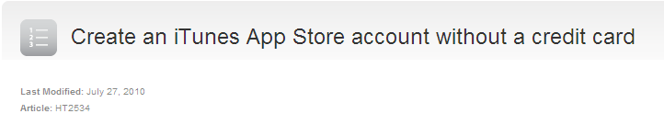

This address should bring to a screen that contains the screen shots below
Follow the instructions ( screen prompts) for setting up an iTunes account

Slide 6

Establish an iTunes Store Account
WITH a credit card/gift card type the following address into your computer browser

Slide 7
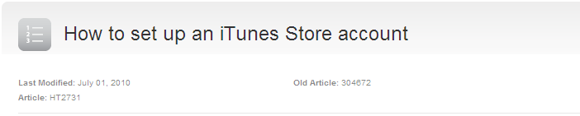
This address should bring to a screen that contains the screen shots below
Follow the instructions (screen prompts) for setting up an iTunes account

Slide 8
After your account is created, sync the iPod with iTunes and this will transfer your account information to the device.
After this initial sync, you never have to sync your iPod touch again if you choose not to the iPod touch can now operate independent of a computer other than charging it.
Now you can disconnect the iPod touch.

Slide 9
3. Load Nursing Central onto your iPod
After you have successful set up an iTunes account you are ready to load the Nursing Central Software onto your iPod
You can do this one of two ways
  On a computer
  On the iPod touch (with wireless internet)

Slide 10
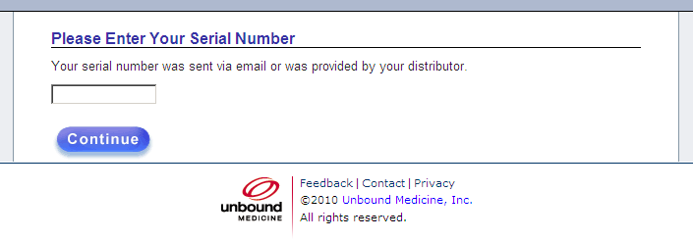
3. Load Nursing Central onto your iPod
On a computer:
  Type/copy the following address into your browser:
  http://www.unboundmedicine.com/register
  Enter your serial number (code) located in the package you purchased from the PTC book store
  Register by following the screen prompts. Try to use the same account info for this as you did for iTunes (username/password)

Slide 11

3. Load Nursing Central onto your iPod
  2. On the iPod touch (with wireless internet)
    Go to the “App Store” on you device.
    Search for “Nursing Central”
    Select “Nursing Central”, tap free, then tap Install
    You will be asked to login to the App Store (using your iTunes password)
    Nursing Central will then install to your device
    Once installed, tap the Nursing Central icon and login with your username and password (try to use the same username/password you used for your iTunes account)
    Your done, Enjoy!!

Slide 12
Once you register your copy of Nursing Central, please visit the Nursing Central web component and log in to access those same resources on the internet. The web component is part of the Nursing Central software package.
They also have a new feature called Grasp, which allows users to build, study, and share decks of cards to master unfamiliar content. Grasp is included in the standard Nursing Central Package. Here is a YouTube video for you to watch that highlights the main features of Grasp:
http://www.youtube.com/watch?v=9kqxam8T7PQ

Slide 13
Support Information
Apple
  http://www.apple.com/support/ipod/service/faq
Unbound Medicine
  http://www.unboundmedicine.com/support
Piedmont Technical College
  Consider asking for help from your classmates/peers first
YouTube Demo
  http://www.youtube.com/user/unboundmedicine#p/a/u/1/SHwdlowOX9c

