Slide 1

Ready, AIM, Enroll!
Presented by:
Matt Dean, Admissions Recruiter
Brenda Edwards, Career Counselor
Tanisha Latimer, Dean of Enrollment Management
Becky McIntosh, VP for Student Services
Notes:
Title Slide

Slide 2

Dr. Jeremy Lord, Consultant
“An Assertive, Managed Approach to Recruiting”

Slide 3
Academic Sales
“Cringe”
Trained to ask the
Right Questions

Slide 4
What We Learned
Focus on Student
The Funnel Concept
4 Point Marketing Message
Many Career Planners
Communications with a Call to Action
The Importance of Data & Reports

Slide 5
Know Your
Marketing Message
Simple, Direct
Repeat it often
In writing, conversation, all media, & presentations

Slide 6
Mission Driven
2 – 5 Words
“Transforming Lives”

Slide 7

The Admissions Funnel
The World
Students

Slide 8
Focus
on the
Student

Slide 9
“Knee to Knee”
“Eye to Eye”

Slide 10
WOW

Slide 11
Next
Marketing Points
Matt
Career Training
Affordability
Quality
Transferability

Slide 12






At PTC, it’s not just about the numbers!

Slide 13



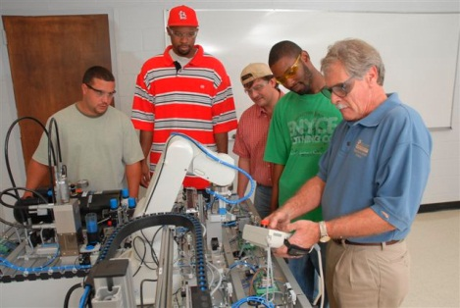
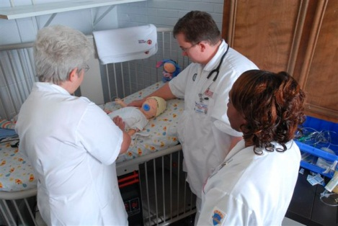
It’s All About the Students

Slide 14


Slide 15
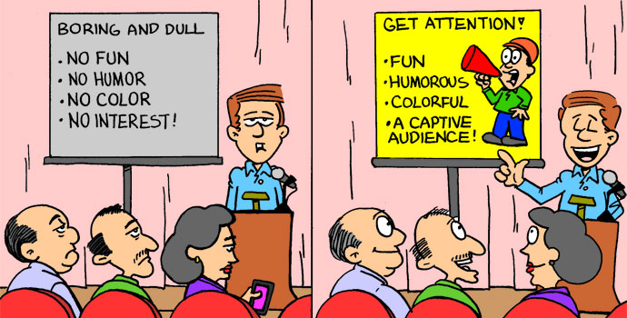
Enrollment Workshops

Slide 16

Apply for admission.
Meet with an enrollment advisor.
Apply for financial aid.
Attend orientation.
If you are a nursing or health science major, attend a Health Science Information Session.
Purchase Textbooks.
Submit High School and College transcripts to Admissions office.
Pay tuition and fees.
Take the placement test (unless waived).
Notes:
Your seventh step is to attend Piedmont Technical College’s Student Orientation. (Click.)

Slide 17
  Admissions
1
  Financial Aid
2
  Placement Testing
3
  Advisement and Registration
4
  Orientation
5

Slide 18
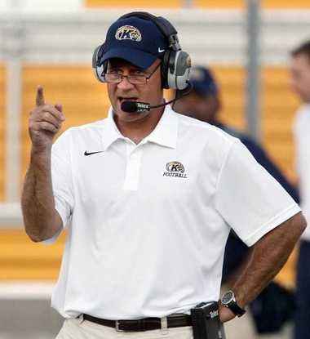
AIM Coaches:
How Do We Do It?
ADMISSIONS INTAKE MANAGEMENT

Slide 19
Where We Began
4 hour blocks per week
In Admissions Office
Coaches assigned by major
Assist walk-in students

Slide 20

AIM Team
14 AIM Coaches

Slide 21
Where We Are Now…
4 hours a week
In personal office
Monthly Meetings
Year Long

Slide 22
Still Evolving…
County Campus Coaches
Presentation Training
Continuous Coach Training
Telephone
AIM Coach Performance

Slide 23
Reports &Data
# Applications
#Applications Completed
# FAFSAs Filed
Charts & Graphs

Slide 24
Others…
Enrollment Management Report
Applicants Registered
County Campuses
High Schools by Month

Slide 25
Review
Focus on Student, not PTC
Funnel Concept
AIM Team
Marketing Message
Mission Driven
Data Information Knowledge Change

Slide 26
Q & A

