Slide 1
Help Your Students to See
Beyond Reaching Their Goals
Herm Allen, Program Coordinator
Educational Talent Search (TRIO Program)
Tri-county technical college, Pendleton, sc

Slide 2
REACHING OUR GOALS SHOULD LEAVE EVIDENCE THAT WE LIVED A LIFE OF SIGNIFICANCE.
~Herm Allen
©Herm Allen

Slide 3
Life Expectancy
According to the Centers for Disease Control & Prevention (CDC), the life expectancy for Americans today (2012 data) is approximately:
80 Years
©Herm Allen

Slide 4
Exercise
Life Expectancy ~ 80 years
Number of Days Alive = 80 years x 365 = 29,200 days
Calculate #Days Alive = Current Age x 365
Calculate #Days Remaining = 29,200 - #Days Alive
What Will You Do With Your
Remaining Days?
©Herm Allen

Slide 5

Free Your Mind
The Past
©Herm Allen

Slide 6

Free Your Mind
The Past
©Herm Allen

Slide 7

Free Your Mind
Hurts/
Mistreatments
©Herm Allen

Slide 8

Free Your Mind
Bad Decisions
©Herm Allen

Slide 9
4 Questions to Making Better Decisions
1. What is the BEST thing that could happen if I make this decision?
2. What is the WORST thing that could happen if I make this decision?
3. Am I willing to RISK #2 to get #1?
4. What will I DO if #2 happens?
Bad/Poor Decisions Paralyzes Us From Making Future Decisions
Bad/Poor Decisions Creates a Fear of Failure or Being Seen as a
Failure
©Herm Allen

Slide 10
What It Means to FAIL
Feedback Always Increases Learning
©Herm Allen

Slide 11

Orient Yourself to Excellence
State of Mind
©Herm Allen

Slide 12

Orient Yourself to Excellence
Attitude
©Herm Allen

Slide 13

Orient Yourself to Excellence
Set the
Standard
©Herm Allen

Slide 14

Orient Yourself to Excellence
Character is the Key
Habits
Virtues
Vices
©Herm Allen

Slide 15
Orient Yourself to Excellence
Character is the Key
As you journey along towards reaching your goals be aware that your character can work for you or against you. That is why it is
of the utmost importance to build strong character
to avoid a weak reputation.
Excerpt from F.O.C.U.S.-5 Essential Principles to
Reach Your Goals for Students & Other Smart People
©Herm Allen

Slide 16

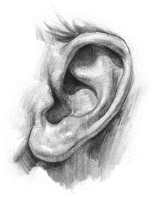
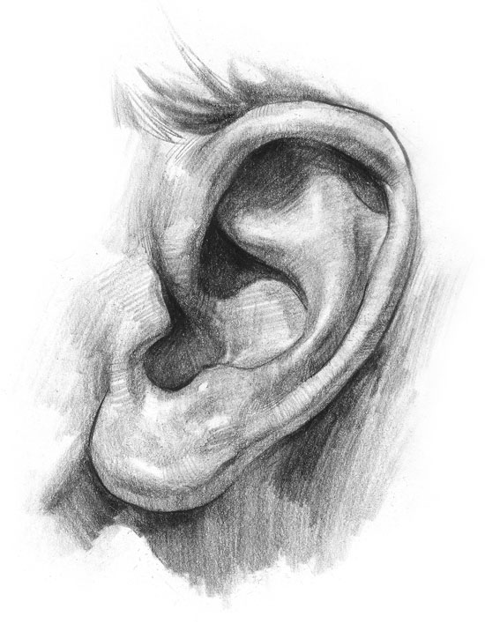

Create a New Mindset
Protect Your
Gates
©Herm Allen

Slide 17









Create a New Mindset
What is flooding our students’ gates?
©Herm Allen

Slide 18

Create a New Mindset
Who are you listening to? What are you listening to?
Select Positive Inputs
What are you watching? What are you saying?
©Herm Allen

Slide 19





Use Your Resources
People
©Herm Allen

Slide 20



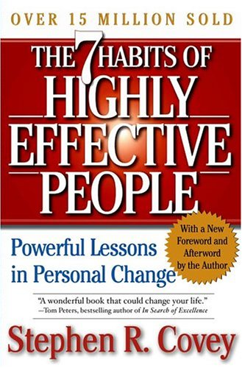
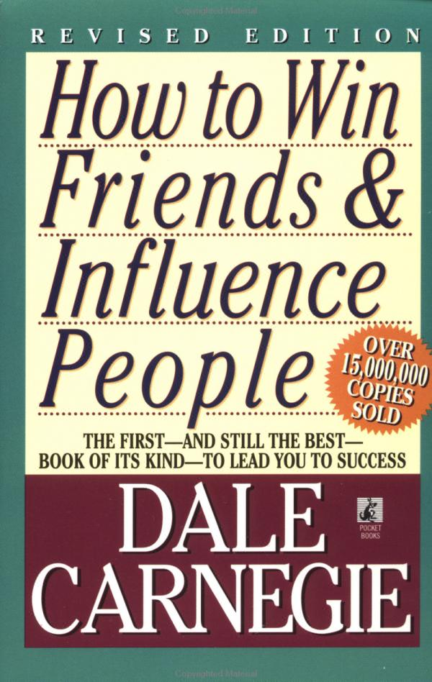
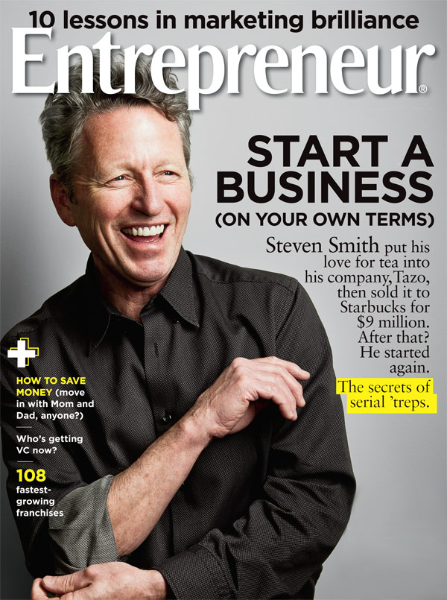
Use Your Resources
Print
©Herm Allen

Slide 21






Use Your Resources
Audio/Video
©Herm Allen

Slide 22

Seek Significance
Develop a Keen Sense of Who They Are
Beliefs
Values
Strengths/Challenges
Emotional Intelligence
Who Are You Becoming?
©Herm Allen

Slide 23







Seek Significance
Identify What Is Important to Them
©Herm Allen

Slide 24
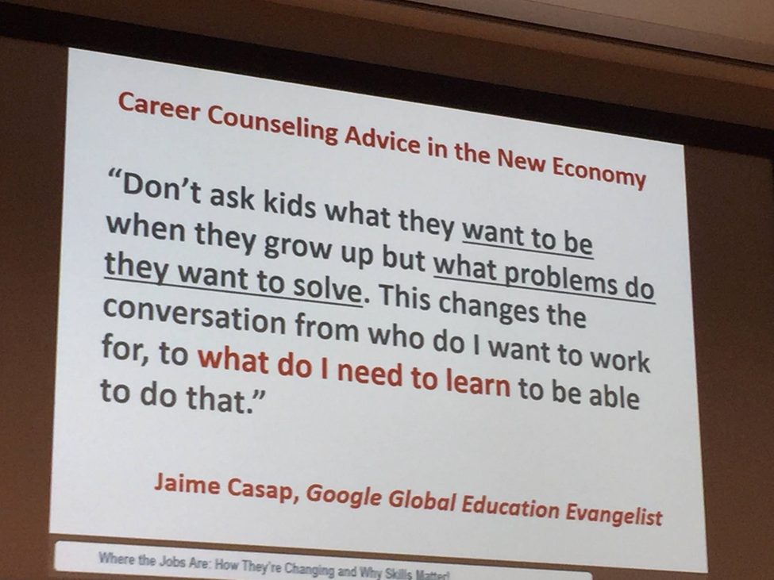
Seek Significance
Make a Difference in the Lives of Others
©Herm Allen

Slide 25

Any Questions/Comments?
©Herm Allen

Slide 26
Final Thoughts
“…do not leave this side of the earth with your talents, abilities, and knowledge still within you as they are no good to anyone when you are gone. We all have something to contribute to society and to the world and it is our responsibility to tap into it and give it away…because we can’t take it with us.” ~Excerpt from F.O.C.U.S.
Die empty.
Leave nothing inside.
Share with the world what you have.
Live a life of significance.
Leave a legacy.
©Herm Allen

Slide 27
REMEMBER…
REACHING OUR GOALS SHOULD LEAVE EVIDENCE THAT WE LIVED A LIFE OF SIGNIFICANCE.
~Herm Allen
©Herm Allen

