Slide 1


Slide 2

LEAN IN HIGHER EDUCATION: How it Changed Our Culture
2012
National Bellwether Award Finalist
Notes:
Title Slide

Slide 3


How Lean Changed Our Culture
  Faculty/Staff:
    Responsible, Accountable for Process Change/Redesign
    Engaged – Making Things Happen!
    Understand Expectations; Evaluated Annually

Slide 4
MORE VALUE LESS WASTE:
A New Way of Thinking at PTC
Notes:
Title Slide

Slide 5


Slide 6


Slide 7

Notes:
Our students come first!

Slide 8

Un-optimized Processes =
Unhappy Students

Slide 9

Process Time
95%

Slide 10
IMPACT
HOW
WHY
Notes:
Let’s Get the Gears Turning!

Slide 11

History of Lean
In manufacturing 100+ years
Toyota Production System (TPS)
1980’s and Beyond – Service Industries
Remove WASTE (Muda)
Culture Change

Slide 12
What PTC means by Lean
Customer/Student Focus
Studying Processes
Identify/Removing Waste
Root Cause(s), not “Symptoms”
AIM: IDEAL State (Pursuit of Perfection)
Tools: Observation, Value Stream Mapping, A3, 5S

Slide 13
How Many “Wastes”?
The 7 Wastes of the TPS
The 8th Waste – Unutilized KSAs
At PTC, we:
  Focus on the 7 Wastes
  Combat the 8th Waste by
  Getting Everyone Involved!

Slide 14

1. Confusion
2. Needless Motion
3. Waiting
4. Processing
5. Inventory
6. Defects
7. Over-production

Slide 15
Lean Is/Is Not
Is | Is Not
A collection of tools that allow us to make data-driven decisions Part of a Continuous Improvement methodology An approach that requires us to think and act differently An endeavor that requires the cumulative knowledge, skills, and abilities of all involved | A strict cost-cutting strategy A headcount reduction strategy A short term “fix” or Band-Aid A cookie-cutter approach “The flavor of the month”

Slide 16
WHY: | Growth | Student Experience | State Funding Cuts
HOW:
IMPACT:
Notes:
To cultivate a new way of thinking
More Value, Less Waste
To identify and eliminate waste
To make our processes run smoother and move closer to IDEAL!!!
To make our work (and our lives!) easier
To help us meet or exceed our customer’s expectations

Slide 17
Desire to Grow

Slide 18
Student Experience
Recruitment
Retention
Satisfaction
Completion
Placement
Lessons Learned:
Communication is Critical!

Slide 19
State Funding Cuts

Slide 20
Student Enrollment vs.
State Appropriation

Slide 21
WHY: | Growth | Student Experience | State Funding Cuts
HOW: | Program Foundation | Contextual Training | Workbook Redesign
IMPACT:

Slide 22
Program Foundation
“Lean 101”
Learned to Identify Waste
Est. Lean Steering Committee
SCMEP Trained Core Group
Internal PTC Trainers Selected

Slide 23
Contextual Training
16-hour PTC Lean Class
Taught by Internal Trainers
  (3) LEAN Projects/Person
  Coached by PTC Lean Grad.
  Faculty/Staff Expectations

Slide 24
INNOVATION: Workbook Redesign
Original Materials - Healthcare Perspective
Education Examples
  Facilitate Learning
  Expedite Culture Change

Slide 25
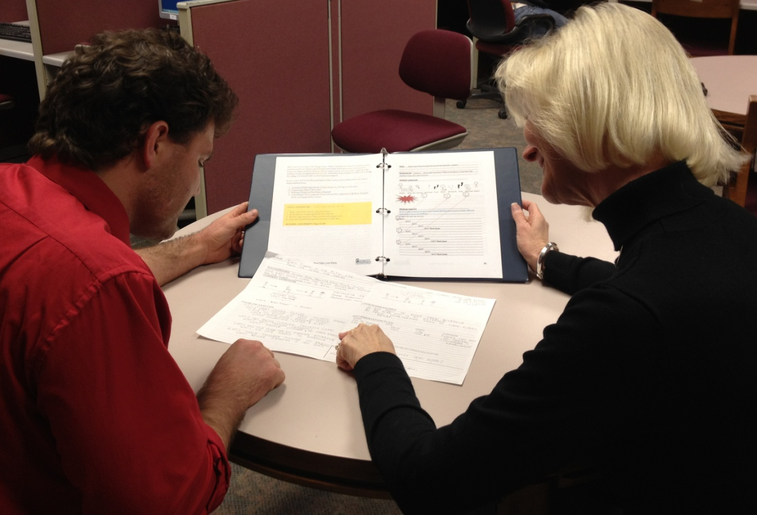
BEST PRACTICE:
Coaches Play a Critical Role
Ask questions & give feedback
Make recommendations to Steering Committee
Dr. Donna Foster, Dean, Arts and Sciences/Transitional Studies,
Alex Miller, Instructor, Philosophy

Slide 26
Employee Engagement to Date

Slide 27
WHY: | Growth | Student Experience | State Funding Cuts
HOW: | Program Foundation | Contextual Training | Workbook Redesign
IMPACT: | Internal Impact | Student Impact | Community Impact

Slide 28
Internal Impact
  Ineffective Mailing Processes
  Timesheets
  Data Processing Backlogs
  Lack of Standard Reporting
  Welding Tanks Process
  Intra-Departmental Communications

Slide 29
LEAN IN ACTION: Value & Benefits
Title: Student Success Center Virtual Class Visits
Action: Changed the Process
Results:
  Reduction of Staff Time
  Improved Consistency of Information
  Increased the Number of Students Informed

Slide 30
LEAN IN ACTION:

Slide 32

LEAN IN ACTION:
Grow Module

Slide 33
Student Impact
  Processing Student Loan Applications
  Paper Waste
  Help Desk Process
  Student Benches and Chairs G&F/ G&D
  Use of Non-Standard Lab Devices
  Communication Between Departments and Students

Slide 34
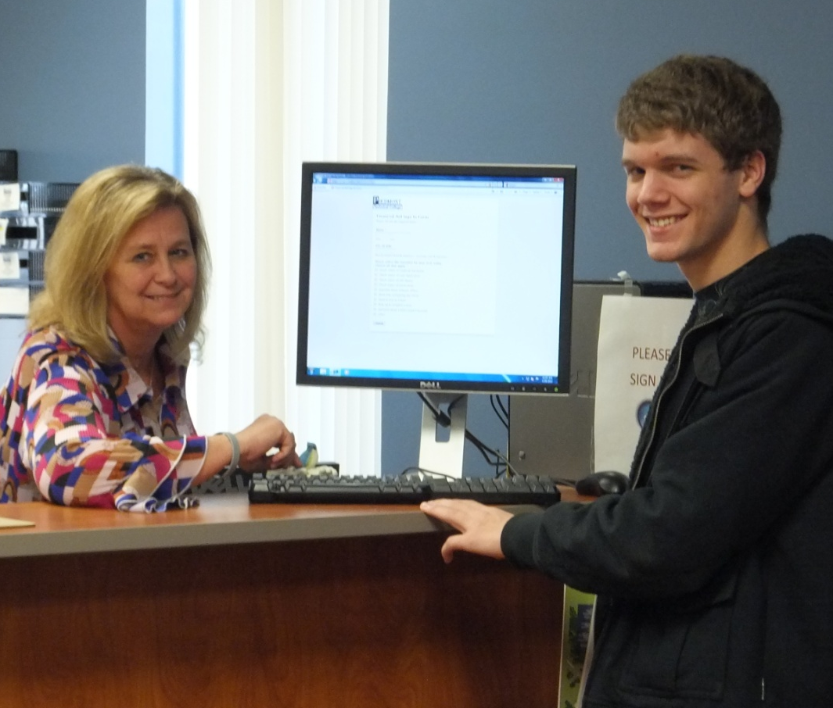
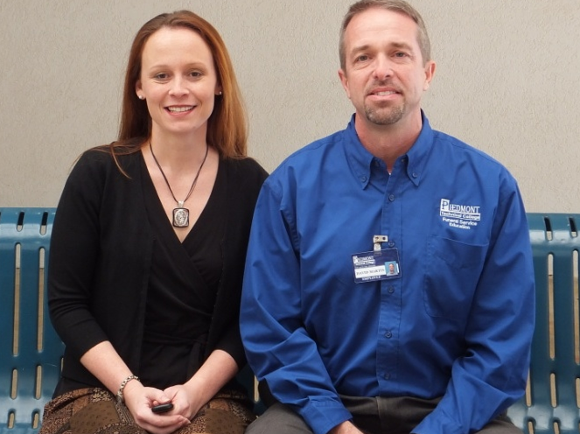
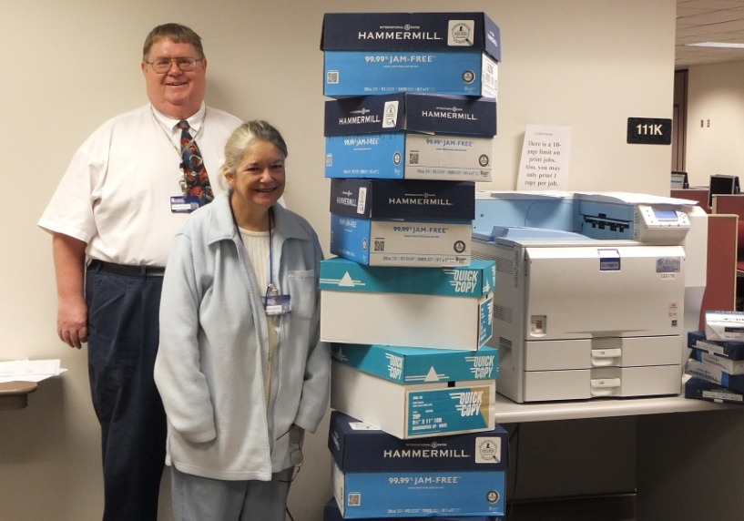
WASTE REDUCTION
Wanda Vanderhoof, Admin Specialist, Financial Aid office
David Martin, Funeral Services
Ashley Hollingsworth, ECD
Dee Sumerel, Dept. Head,
Chuck McDonnell, Instructor

Slide 35
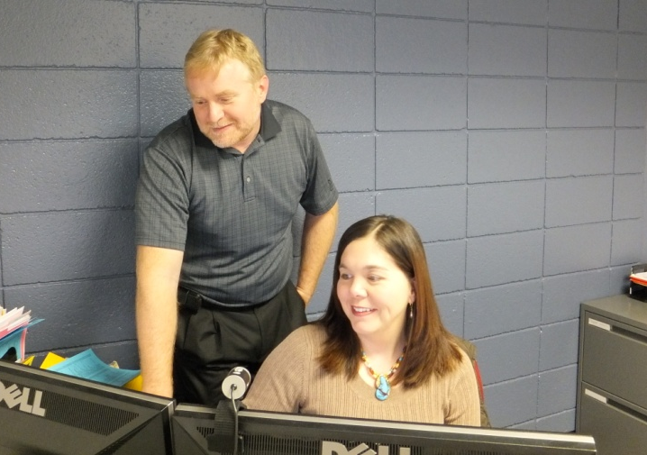
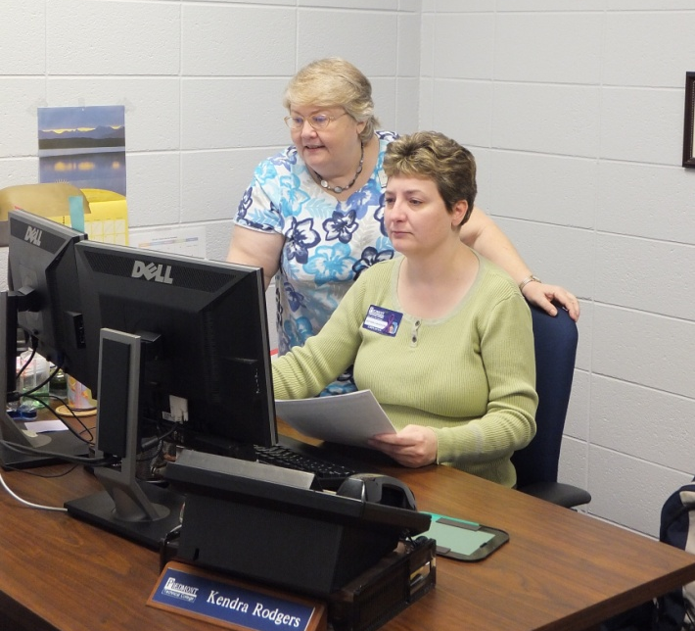
PROCESS IMPROVEMENT
Greg Colley, Instructor Mathematics. Jennifer Stroud, Admin. Assistant, Distance Learning
Kendra Rodgers, Processing Center Coordinator, Debra Auten, Enrollment Specialist

Slide 36
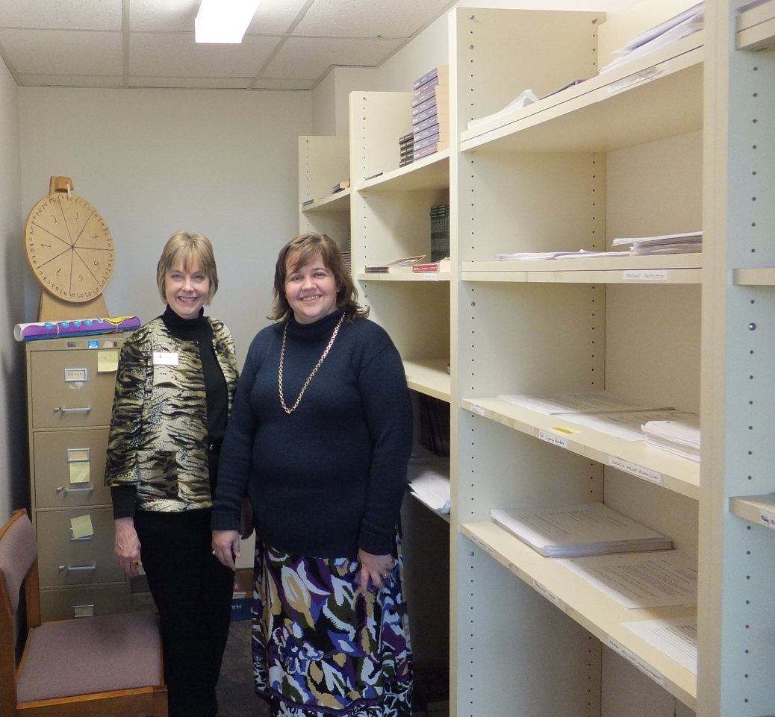
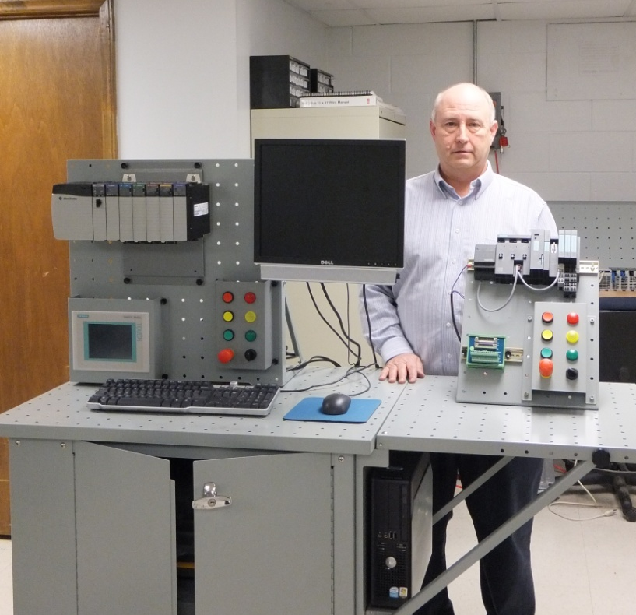
5S/STANDARDIZATION
Lisa Martin, Developmental Studies,
Joyce Brown, College Skills
Charles Dixon, Instructor, Industrial Electronics

Slide 37
BEST PRACTICE: Community Impact
  Senior Nursing Students - A3 Projects
  Welding & Automotive Students Use Lean Tools/5S
  Processes & Communication Between PTC and Our Customers Streamlined

Slide 38
Community Impact

Slide 39
WHY: | Growth | Student Experience | State Funding Cuts
HOW: | Program Foundation | Contextual Training | Workbook Redesign
IMPACT: | Internal Impact | Student Impact | Community Impact
STUDENT
SUCCESS

Slide 40
Lessons Learned
It’s a Journey
Need Structure
Didn’t Know What We Didn’t Know
People Learn and Change at Different Speeds
Tracking Measurable Results in Education Different From Manufacturing
The Tools are Easy;
Changing Mindset is Hard!
Critical to Our Future

Slide 41
Implementation Roadmap

Slide 42
Reduce Waste; Improve Processes; Delight Customers
Define, Articulate Aim of Lean in Your Org.
Develop Impl. Plan; Provide Training
Apply Training to Real World Situations
Coach/ Mentor; Modify as Necessary
Measure Results; Continuously Improve
Lead by Example

Slide 43
College Impact

Slide 44
College Impact

Slide 45
SUMMARY & CLOSING
Move Towards IDEAL
Eliminate WASTE
Improve EFFICIENCY and EFFECTIVENESS
Empower EMPLOYEES / Enhance MORALE
ULTIMATELY:
ADD MORE VALUE!

Slide 46
Q&A
Notes:
Title Slide

