Slide 1

Mandating Orientation as Part of the Enrollment process
One College’s Journey and Experiences…

Slide 4
History/Challenges of the Enrollment Process
  Location of Advising Center
  Unmanageable Numbers
  Wait Time
  Web Advisor Online Registration
  Previous Attempts at Orientation

Slide 5
The Theory

Slide 6
Educational Theory to Support the Initiative
  Change
  Competence
  Connection
  Strategic Imperative - Student Success

Slide 7
The Timeline

Slide 8
Implementation of Orientation
  What we were doing
  Motivation for the change
  Overview of Research/ATD

Slide 9
Progression of Orientation
Fall 2009 – Orientation Discussions began
Winter 2010 – Task Force Formed
Fall 2010 – Orientation only
Spring 2011 – Orientation and Registration
Fall 2011 – Last minute “Round Robin” Sessions
Spring 2012 – Divisional Cohorts

Slide 10
Various Delivery Methods
  Non-restricted traditional
  Orientation for non-traditional students
  Round Robin
  Divisional

Slide 11
The preparation

Slide 12
Orientation Sign-Up
  Students must first:
    Complete the admissions process and be formally accepted to the college
    Activate their GTC4me account
  Students may then sign-up online to attend

Slide 13
Orientation Registration
Students log in to a registration site in GTC4me and complete an online questionnaire
A daily report of students who have registered for orientation is generated
From this report, advisors are able to create a custom advising sheet for each student

Slide 14
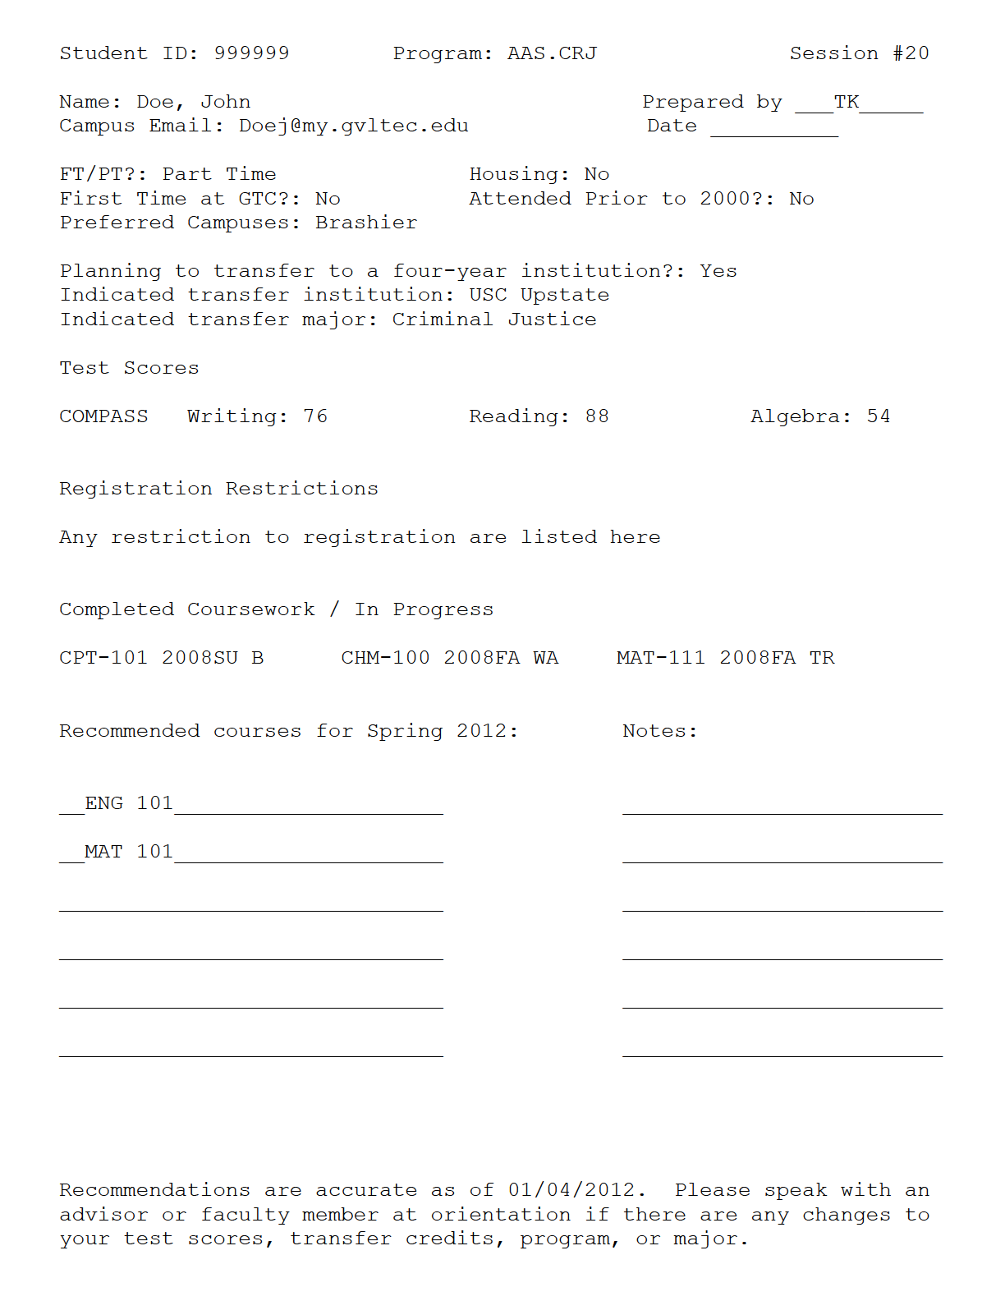

Slide 15
Advising Packet
  Advising Sheet
  Program Information
    Audit Sheet
    Special Instructions/Departmental Letters
  Information about Special Programs for which the student qualifies

Slide 16
The Event

Slide 17
Check In
Non-advising staff volunteers to help with the check in process
The number of check in lines is based on the number of students attending.
Students must show a picture ID
Students receive
    Resource Guide
    Advising Packet

Slide 18
Parent/Guest Session
Separated immediately after check in
Mirrors students’ session
  Emphasis on support role
  Financial Aid
  FERPA

Slide 19
Welcome Session – “Who will you become?”
  A video is played to introduce students to GTC
  Expectations of the day are outline by the Presenter
  Students are greeted by various College representatives
  A “Did You Know” video is played from YouTube

Slide 20
Advising Presentation
Consistent delivery of information
    Three focal points
      Information and Sources at GTC
      Things to know and think about when registering for classes
      The basics of registration
        Video

Slide 21
Divisional Presentation
  Students separated into four groups
  Each division has developed their own presentation
    Example: health science students attend a career talk as part of their clinical application
  Meet faculty and often the Dean of their division
    Helps to transition the students into the classroom more smoothly

Slide 22
Registration Sessions
Faculty and Professional Advisors provide assistance
Students self-register
    Customer Service challenges
    Information Availability
Every effort is made by advisors to ensure there are no restrictions on a student’s account so that each student leaves the lab with a schedule.

Slide 23
The results

Slide 24
Trends
Tutoring explosion
Manual to online reg. transition

Slide 25
Purely Online Registration (%)

Slide 26
Trends
Tutoring explosion
Manual to online reg. transition
Survey results
Persistence Data

Slide 28
Trends
Tutoring explosion
Manual to online reg. transition
Survey results
Persistence Data
Too early for graduation data

Slide 29
The Good | The Bad | The Ugly
Running Advising Reports more often Electronic Advising Worksheet Resource Guide Information Prior to Enrollment College Wide Engagement | Unofficial Transcripts Change of Portal Invite President to first month of orientation Questions on Registration Form (LIFE) | June 29,2010 Ice Storms Ants in Snacks Expired Water

Slide 30
Students
Faculty
IT
Administration
Advisors
Support Staff
Marketing
Police Department

Slide 31
The future

Slide 32
Future Plans
Pre-Advising Module
Improve Online orientation experience
Increase Student Involvement
Establish Budget and Department
Divisional/Departmental Filters
Add personality and personalities (peoples’ stories)
Where do we go from here?

Slide 33

Questions

Slide 34
Contact Us
Dr. Chuck Morton, Brashier Campus Director
  Dr.Chuck.Morton@gvltec.edu
Berta Keene, Dean of Academic Advising
  Berta.Keene@gvltec.edu
Deborah Sears, Academic Advisor
  Deborah.Sears@gvltec.edu
Tim Kelly, Academic Advisor
  Tim.Kelly@gvltec.edu

