Slide 1

The First Year Matters:
In Pursuit of Excellence in the Two-Year
Beginning College Experience
New Directions in Student Development
Piedmont Technical College
Greenwood, South Carolina
March 8, 2012
John N. Gardner

Slide 2

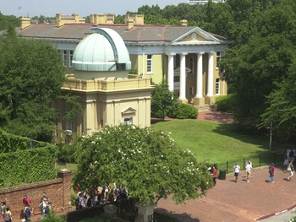
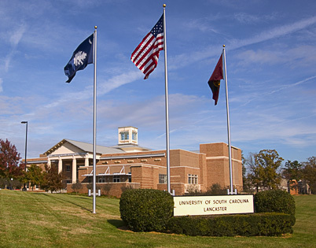
My Personal/Professional
History with Your State
Shaw AFB, SC…
my first college teaching

Slide 3
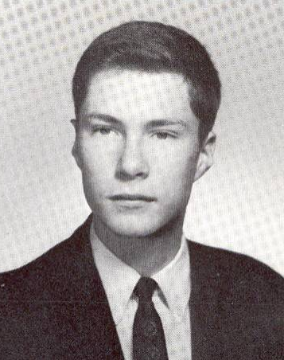
An opening confessional!
John Gardner was not a successful beginning college student.

Slide 4
These were my first grades:
F
F
F
D
D
A

Slide 5


And this was something I did well:

Slide 6
Colleges are Built Around Big Ideas

Slide 7



And these are some big ideas
I remember from my first year:
And this was a source of finding purpose in life after college:
the pursuit of social justice

Slide 8
All I ever needed to know about success as a higher educator, I learned in my first year of college
Example: Speech 101—need to identify with an audience
My first semester’s grades: 3F’s, 2D’s, 1A—what’s the moral
of that story for teaching in open admissions settings?
The importance of other students as exemplars
Don’t settle for anything less than outstanding academic advising
The importance of out-of-class student faculty interaction
The importance of joining at least one co-curricular activity

Slide 9
All I ever needed to know about the gratifications of college teaching
I learned in my first teaching in a two-year college
Four Things I Most Love (what are yours?)

Slide 10
Reading
Writing
Talking
Helping people

Slide 11
My first campus in contrast to yours
Was a two-year constituent unit of a public, flagship, university
The University of South Carolina at Lancaster
Rural, southern textile mill town
Open admissions
Non-residential
Many non traditional students
Different student demographics

Slide 12
My big take away lessons as both adjunct faculty member and Vice Chancellor for Academic Affairs:
For faculty it can be a grind teaching a steady diet over a career of just beginning college courses –
so faculty development is even more important
New students’ ACT/SAT scores do NOT predict
their motivation and basic intelligence
Those scores also do not predict campus personnel’s motivation and abilities to help
those students

Slide 13
I am still pursuing big questions
Now my big question is: What constitutes an excellent first year of college and how is that implemented?
And to achieve this how might we improve Student Affairs/Academic Affairs partnership?

Slide 14
What is the First-Year Experience®?
a registered trademark
a program
the entirety of the beginning college experience
multiple first year experiences for: developmental, matriculated, ESL, dual credit, concurrent, probationary, readmit, advanced placement, students

Slide 15
What is the First-Year Experience®?
a philosophy that says “the first-year matters”
whatever you want it to mean
whatever your College means by this
something quite different perhaps from YOUR first-year experience

Slide 16
Let’s turn to the beginning college experience and let’s start with the obvious:
Why is the beginning college experience important?

Slide 17
It is the Foundation for . . .
the undergraduate curriculum
choosing a major
establishing a good GPA
learning good study habits
developing “economies of time”
developing positive attitudes toward faculty
getting in the habit of interacting with faculty
outside of class

Slide 18
The Foundation for . . .
developing positive attitudes toward the College
developing long term relationships that will last through and beyond college
deciding on which groups to affiliate with
acquiring behaviors that may carry over beyond college
redefining roles between students and family members, and employers
introducing students to civic engagement
providing a baseline for assessment of student characteristics, behaviors, and learning outcomes

Slide 19
This has to be more than about retention!
Retention is not an aspirational goal
It is a minimum standard
But important nevertheless
Retention is an institutional goal, not a student goal
Goals have to connect to value added: what have students learned, now able to do, how changed, etc.
I suggest a different goal: educational excellence in the new student experience

Slide 20
Think globally, act locally
So What Can I Do Directly With Students?

Slide 21
What does this mean?
It means incorporating into your practices the research based knowledge we have accumulated about what practices lead to student success in your setting.

Slide 22


A Foundation for Excellence in the First Year of College: Student Affairs/ Academic Affairs faculty partnerships.

Slide 23
Some basic assumptions:
SA has to take the initiative
The academic mission is preeminent
This is not about achieving the unrealistic goal of AA/SA parity
The faculty is not the enemy
This is about advancing overall institutional objectives to achieve enhanced student learning and success outcomes (institutional mission statement)

Slide 24
Some basic assumptions:
SA work is changing from historic “out of sight out of mind” to one now that is of much higher priority to senior collegiate leaders because they already recognize the importance of SA contributions. This is good news, bad news story. Means that your work has more visibility to academics, and could even mean they might want to absorb certain SA functions into AA.

Slide 25
Some basic assumptions:
Because of resources squeeze assessment of outcomes and then sharing results is more important than ever. In terms of results, what matters most is what you did to improve educational outcomes as a result of the assessments you conducted.

Slide 26
Some basic assumptions:
Key question is how does your unit(s), your work individually, support student learning?
And from a societal perspective, this is all about achieving social justice

Slide 27
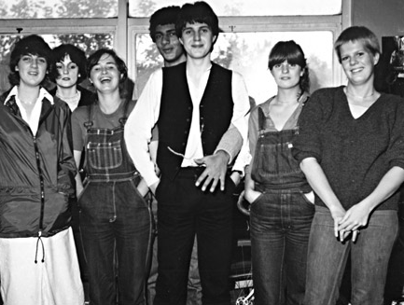
History of SA profession and demographics of campus administrative leadership are converging to the advantage of SA; more and more there are senior campus leaders who themselves actually experienced delivery of and benefitted from SA contributions when they were undergraduates.

Slide 28
Three basic areas for productive focus:
What can better be done at the College level?
What can be done at the unit level?
E.g. You have orientation at the College level. What about the unit level?
The individual level

Slide 29
Key undergraduate student transitions, represent best possible areas for AA/SA partnerships:
the developmental pre matriculation experience
the first-year experience*
the transfer experience
the sophomore year experience*
*see sources

Slide 30

And within the focus on the first year are the most extensive and rich targets of opportunity for partnerships
(please use the following as a checklist)

Slide 31
Opportunity for Partnerships
first-year seminars
learning communities
Supplemental Instruction and academic support
special administrative units
(e.g. University/General Colleges – Why are these lacking in
two-year colleges?)
orientation
academic advising
career planning linkages to academic advising

Slide 32
Opportunity for Partnerships
peer leaders
service learning
early alert
summer bridge
developmental education programs/courses

Slide 33
Opportunity for Partnerships
high failure rate courses
STEM focus, especially on math failure rates
financial aid counseling/advising, financial literacy
internship opportunities

Slide 34
Opportunity for Partnerships
increasing faculty-student contact outside the classroom
student activities
first year as a focus for assessment
linking to professional/SACS accreditation efforts
moving beyond “programs” to developing a comprehensive plan for the first year
(e.g. Foundations of Excellence®)
implementing that plan

Slide 35

The following are the most common functional program and service delivery areas that pose optimum opportunities for
AA/SA partnerships:

Slide 36
Opportunities for AA/SA partnerships
orientation
advising/counseling
first-year seminars
learning communities
service learning
student activities connected to academic majors/units
And I would especially like to see added
a focus on high DWFI rate courses

Slide 37

Another possible type of focus is partnerships to address “critical junctures” - particular events or decision points that occur within or throughout one of these transition periods

Slide 38
Regarding Critical Junctures:
they may overlap and have an even greater impact
how is your College organized to address these?
for which junctures is support strongest/weakest
in which junctures do you lose the most students?

Slide 39
Critical Junctures: Academic
initial placement exams
moving in/out of developmental ed or ESL
challenges of gateway courses
declaring or changing a major
being at second choice institution
being forced to seek alternatives to first choice major

Slide 40
Critical Junctures: Academic
moving into or out of academic probation
moving from full-time to part-time status (and vice versa)
transfer

Slide 41
Critical Junctures: Social/ Personal
affiliation with campus social groups
(acceptance or rejection)
elimination from athletic team
coming out
romantic breakup

Slide 42
Critical Junctures: Social/ Personal
problems at home: divorce, illness, child care
financial problems (loss of employment or major financial reversals)
losing/gaining scholarships/financial aid
moving from dependent to independent tax status

Slide 43

Increasing institutional responsibility for student learning:
Who is responsible for student learning: us/them?

Slide 44


Policies that might promote greater student success:
class attendance
course placement
enforcing course prerequisites
mandatory advisement
mandatory orientation

Slide 45
Policies that might promote greater student success:
addressing problems of late application/admission
and class start
mandatory enrollment in first-year seminars
mandatory participation in SI
reexamining our mantra that requirements constitute
a barrier to student success
employment on campus
…and so many others!

Slide 46

What are the policies that need to be jointly reviewed by SA/AA?
I Recommend You Do a Policy Audit!

Slide 47
Suggestions for Strategies and Activities to Enhance SA/Faculty/AA partnerships
Conduct an inventory of current partnership initiatives
Rate effectiveness of each
Create a matrix of all academic majors/credit granting units and note which ones have some kind of SA supported co-curricular group/activities connected to
that academic unit. Also note which ones have
faculty advisors.

Slide 48
Suggestions for Strategies and Activities to Enhance SA/Faculty/AA partnerships
Create stakeholder advisory groups for major SA programs that support new students: advising, orientation, first-year seminar, etc. Invite faculty to serve on these groups.
Undertake campaign to increase extent of faculty participation in roles of faculty advisors to student groups

Slide 49
Suggestions for Strategies and Activities to Enhance SA/Faculty/AA partnerships
Assist faculty in recruiting of student cohorts for research purposes related to faculty members’ disciplines
Create position(s) of faculty internships in
Student Affairs
Invite faculty to attend SA professional meetings
Co-host/co-sponsor forums, colloquia with academic units on topics of mutual interest

Slide 50
Suggestions for Strategies and Activities to Enhance SA/Faculty/AA partnerships
Assist in dissemination of information on value of service learning and provide support for administration of service learning
Propose standing committee in faculty governance system on Student Life (if one doesn’t already exist)
Collaborative work on issues of classroom conduct and academic integrity

Slide 51
Suggestions for Strategies and Activities to Enhance SA/Faculty/AA partnerships
Design occasions to bring students, faculty, and SA professionals together for meals.
Introduce selected faculty to some of the key published works of your discipline.
Share assessment data generated by your Division on nature of your students and their experiences at your institution.

Slide 52
Suggestions for Strategies and Activities to Enhance SA/Faculty/AA partnerships
Co-host campus-wide forums, retreats, colloquia, symposia on topics about the student experience that could draw faculty participation.
Offer some of your services to faculty and their dependents (e.g. counseling, learning support, etc).
Invite faculty to serve on your committees.

Slide 53
Suggestions for Strategies and Activities to Enhance SA/Faculty/AA partnerships
Provide professional development workshops/ seminars on topics of mutual interest to your colleagues and faculty.
Solicit faculty nominations of their best students for student leadership positions in your units (e.g. peer leaders for Orientation, first-year seminars, etc).
Invite faculty to your social functions

Slide 54
Suggestions for Strategies and Activities to Enhance SA/Faculty/AA partnerships
Offer awards and other forms of recognition for exemplary contributions by faculty members.
Key is to do the above on an organized, systematized, recurrent basis and not as series of unconnected one-offs.

Slide 55
Remember: Most of your students are first-year students and some are just like I used to be...
…and that YOU can make a huge difference for providing foundations for the first-year experience.

Slide 56

Thank You Ladies and Gentlemen
John N. Gardner, President
John N. Gardner Institute
for Excellence in Undergraduate Education
gardner@jngi.org
828-449-8044
www.jngi.org

