Slide 1
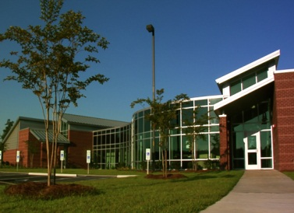
Satellite Campuses
Survival of the Fittest!

Slide 2

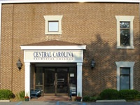
Contact Information
Allison Jeffords – Program Manager
Central Carolina Technical College
Kershaw County – Satellite/Outreach
1125 Little Street
Camden, SC 29020
E-mail: jeffordsae@cctech.edu
Phone: 803-425-8388
Fax: 803-432-8550

Slide 3


Agenda
Central Carolina Background
Student Services
Satellite Locations
Satellite Enrollment
Kershaw County Specifics
Services
Services/Support
Student Life
Communication
Tracking/Documentation
Strategic Plan
Sharing Session

Slide 4
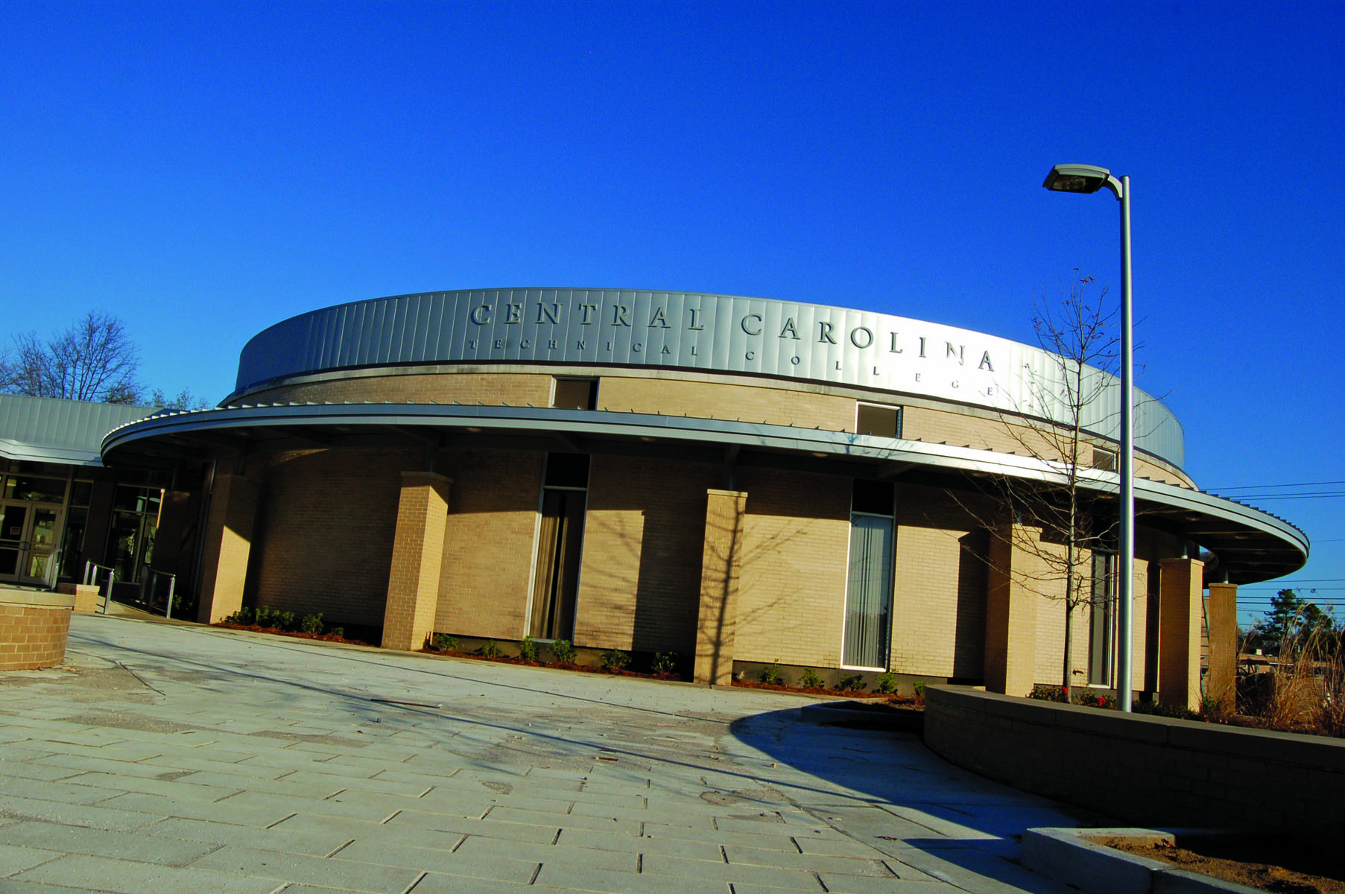
Central Carolina Background
Two-year Technical College, 1962
Main Campus – Sumter, SC
Average College Enrollment
  Fall 2010 – 4265
  Fall 2011 - 4456
  Spring 2010 – 4152
  Spring 2011 - 4321
Enrollment Increase
  Fall - 4.5%
  Spring – 2.5%
General Demographics
  62% Part Time
  28 Average Age
  69% Female, 31% Male
  Race – 43% White, 50% Black, 2% Hispanic, 1% Asian,
  4% Unknown
College Values - Excellence, Integrity, Innovation

Slide 5
Central Carolina Background
50 Programs of Study (2010)
  16 Associate Degrees
  5 Diplomas
  32 Certificates
Online courses available
  Desire 2 Learn (Learning Management System)
6 Satellite Locations
College Values - Excellence, Integrity, Innovation

Slide 6
Student Services Available at CCTC
Admissions and Counseling
Student Records
Financial Aid
Disability Services
Career Services
Student Life
Special Populations
TRiO Student Support Services
Testing Services
Tutoring Center
Outreach Campuses

Slide 7
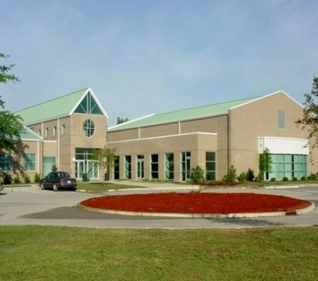
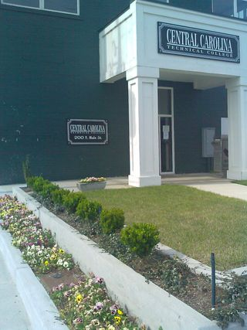
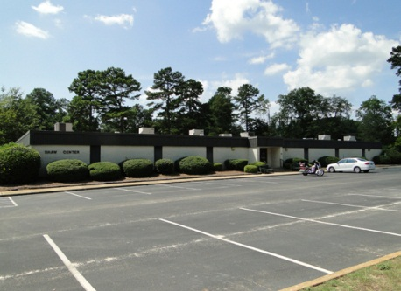
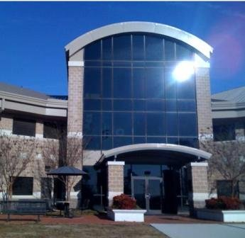
CCTC Satellite Locations
Rhonda Sherman
F.E Dubose Center
3351 Sumter Hwy
Manning, SC
803-473-2531
Allison Jeffords
Kershaw County Downtown Campus
1125 Little Street
Camden, SC
803-425-8388
Jernitha Smith
Lee County Site
200 North Main Street
Bishopville, SC
803-483-2282
Jim Shrift
Shaw Center
2140 Peach Orchard Road
Sumter, SC
803-499-4171
Allison Jeffords
Kershaw County Campus
80 Campus Drive
Camden, SC
803-425-8388
Jim Shrift
Base Education Center
Shaw AFB, SC
803-666-2422

Slide 8
F.E DuBose Career center
  Fall Enrollment
  Fall 2010- 284
    Fall 2011 -303
    7% Increase
Spring Enrollment
  Spring 2010-255
  Spring 2011–270
  6% Increase
Rhonda Sherman – Program Manager
F.E Dubose Center
3351 Sumter Hwy
Manning, SC
803-473-2531
Established - 1998

Slide 9
Lee County satellite
  Fall Enrollment
  Fall 2010 - 83
    Fall 2011 – 95
    14% Increase
Spring Enrollment
  Spring 2010 - 60
  Spring 2011 – 75
  25% Increase
Jernitha Smith
Lee County Satellite
200 North Main Street
Bishopville, SC
803-483-2282
Established 2006

Slide 10
Shaw Center satellite
  Fall Enrollment
  Fall 2010 - 180
    Fall 2011 - 77
Spring Enrollment
  Spring 2010 - 143
  Spring 2011 – 111
Deployments/Staff
Jim Shrift
Shaw Center
2140 Peach Orchard Road
Sumter, SC
803-499-4171

Slide 11
Kershaw County Satellite
  Fall Enrollment
  Fall 2010-525
    Fall 2011-543
    3% Increase
Spring Enrollment
  Spring 2010-497
  Spring 2011–541
  9 % Increase
Downtown Campus
1125 Little Street
Camden, SC
803-425-8388
Kershaw County Campus
80 Campus Drive
Camden, SC
803-425-8388
KC Students represent 15.2% (2010) of CCTC Student Enrollment

Slide 12
Kershaw County Specifics
KC Downtown Campus
  Established 2001
  Shared with County
  General Education Courses
  8 Classrooms
Kershaw County Campus
  Established Summer 2010
  Shared with County
  Classroom
  Biology Lab
  Computer Lab
  24 Welding Booths
  Administrative Assistant

Slide 13
Kershaw County Specifics
KC Downtown Staff
  Program Manager
    Facilities – DT & New
    Admissions/Advisement
    All Other Student Services
  Advisement Specialist
    Advisement/Admissions
    All Other Student Services
  Administrative Specialist
    Front Office
    Student Intake
    All Other Student Services
  Work Study
    20 hrs Weekly
    Front Office
KC Downtown Campus
  All Student Services
    Admissions
    Advisement
    Financial Aid
    Testing
    Books
    Cashier Duties

Slide 14

Services/support
Admissions
Advisement
Financial Aid
Books
Testing
Tutoring Services
Cashier Duties

Slide 15

Admissions/Advisement
Admissions – Program Manager
Advisement/Registration – Advisement Specialist
Peak Times
Fall 2011 Registration – 08/08/11-08/19/11
  826 Students Assisted
Spring 2011 Registration – 01/03/12-01/07/12
  643 Student Assisted
Support: Satellite Quarterly Meetings, Admissions/Program Specific Training

Slide 16

Financial Aid
FA Counselor 1 Day
Wednesdays
  All FA Students
  No Appointments
  9:00 am – 3:30 pm
FA Paperwork
14% KC Students
1,357 KC Students FA Assistance
  Jan 2011 – Dec 2011
Support: Due to request from Satellite Locations, FA Counselor from Main Campus on site 1 day a week at all Satellite Locations.

Slide 17

Books – KC Satellite
Initial Book Order – Main Campus Book Store
Textbooks and Supplies
Face-to-Face KC Classes
KC Students – Online Courses
1,306 Books Sold KC students
  Jan 2011 – Dec 2011
Support: Monitor book inventory during registration – Restock aka KC Book Mobile

Slide 18


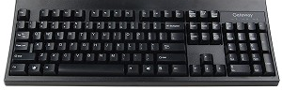
Testing Services
4 Computers
Placement Testing
  E-COMPASS
Online Exams
Faculty Make-up Exams
Biology Placement Test
2,291 KC Students Tested
  Jan 2011 - Dec 2011
Support: NetSupport used for remote monitoring of testing and student computer use in computer labs.
Innovation – Fall 2011, Exams completed in RM 17 – 15 Computers

Slide 19

Tutoring Services
Faculty/Student
Net Tutor
  Summer 2011
  Various Subjects
    Biology
    Information Technology
    Math
    Spanish
    Online Writing Lab
Support: Provides students at Satellite Locations access to tutoring services, and they do not have to travel to Main Campus – Sumter.

Slide 20

Cashier Duties
Program Manager
Advisement Specialist
Administrative Assistant
  KC Downtown Campus
  KC New Campus
1,008 Payments KC students
  Jan 2011 – Dec 2011

Slide 21

Cashier Duties
Outreach Weekly Activities Report
  Began Tracking Deposits
  $91,872.95 Deposits
    Nov 7, 2011 – Feb 24, 2012
Support: Direct communication with Business Office at Main Campus – SPARK

Slide 22
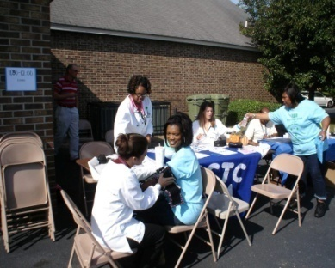
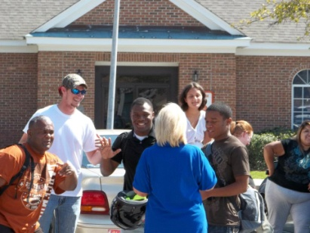
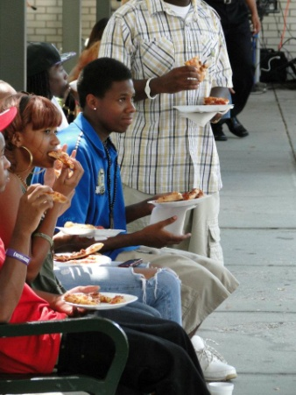
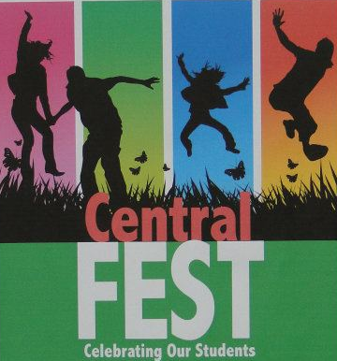
Student Life
Clubs and Organizations
Student Ambassador Opportunities
Bulletin Boards
  Student Life
  Announcements
  CCTC in the news
Support: Various clubs/organizations come to satellite locations to share information about programs/services.

Slide 23
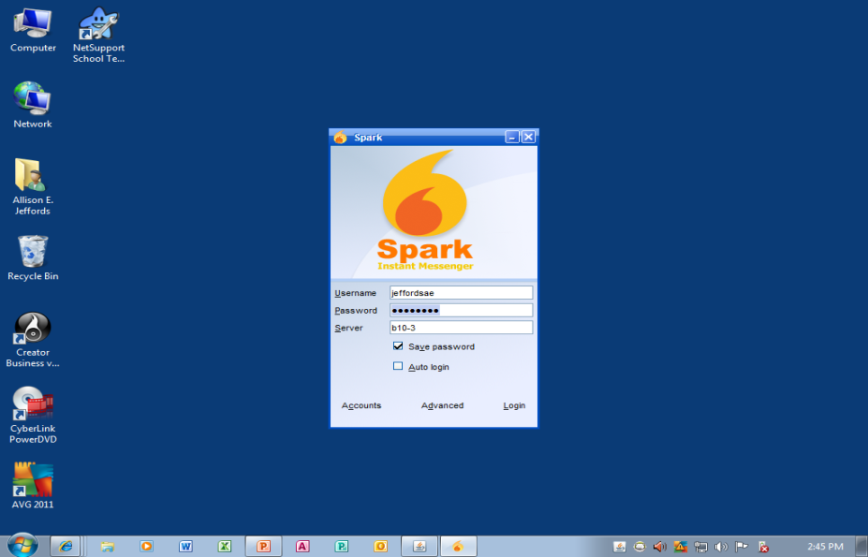
Communication
Telephone
Email
SPARK
  Required Use 2008
  Instant Messaging
  Key Departments
    Admissions
    Business Office
    Financial Aid
    Satellite Locations
    Health Sciences
    Student Records
    Help Desk
    Student Affairs
    Student Records
    Testing Center
Support: Sparks allows connection to Main Campus for assistance. Increases efficiency of task (Admissions, FA, Payment Issues, etc.)

Slide 24

Tracking/documentation
Student Sign-In
  Track Assistance Type
  Determine Needs
  Documentation
    Support Requests
    Supports Growth
Support: Excel spreadsheet – Student signs in for assistance and use of computer lab. Provides documentation concerning traffic/peak times at KC Downtown Campus.

Slide 25

Strategic Plan
Time Period 2010-2015
  Workforce Development
  Educating Students
  Faculty and Staff
  Resources

Slide 26
Strategic Plan
Educating Students
  Goal - 2015 Increase Dual Enrollment (DE) Course Offerings 20%
    Kershaw County Largest Population of DE Students
    Downtown Campus
      2:00 pm – 3:00 pm
      Fall 2011 – Onsite/High Schools
        North Central High School
        Lugoff-Elgin High School
Support: DE Coordinator & Secondary Program Coordinator responsible for supporting area high schools, developing course offerings and hosting DE parent night.

Slide 27
Strategic Plan
Educating Students
  Goal -2015 Increase High School Graduate Enrollment 20%
    Kershaw County
      Lugoff-Elgin High School
      Camden High School
      North Central High School
    2011 Graduating Class
      LEHS – 278
      CHS – 199
      NCHS - 105
Support: Program Manager accompanies KC Recruiter on events. Program Manager also participates in the high school awards ceremonies each year. New Scholars Program for the Class of 2015 – KC, Lee & Clarendon Counties.

Slide 28
Strategic Plan
Resources
  Goal –New Funding & KC Expansion
    KC New Campus
      Summer 2010 – Phase I
      40 Acres
      Phase II – Next Building
Support: Community involvement, KC Chamber of Commerce “Business Before Hours - Breakfast” at new KC Campus. Tracking/Documentation – proof in the numbers.

Slide 29
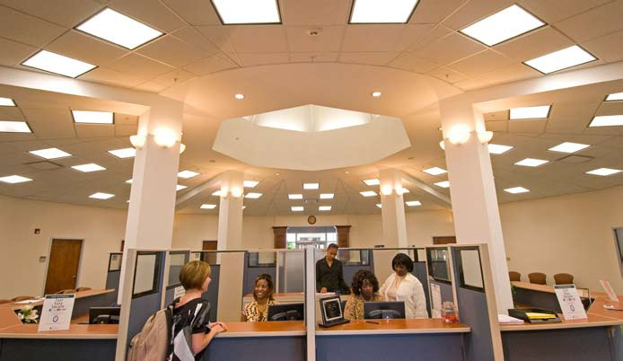
Sharing Session
Comments – Ideas – Suggestions

