Slide 1
THE STUDENT CONDUCT CODE: DECISION v. DEVELOPMENT
Russ Bumba, Ed. D.
Associate Vice President for Student Services and Research
SC Technical College System
March 7, 2014

Slide 2
CHANGES
1972: Title IX
1973: Section 504 of the Rehabilitation Act
1973-1974: Basic Educational Opportunity Grants
(Pell Grant)
1974: Family Educational Rights and Privacy Act
1990: Americans with Disabilities Act
Wikipedia

Slide 3
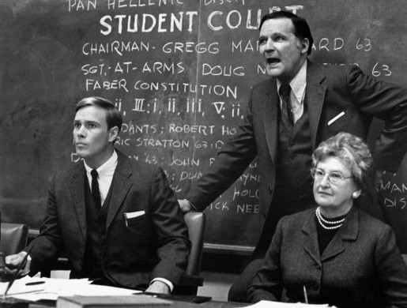
Notes:
1978 film
Delta Tau Chi
Faber College--1962

Slide 4
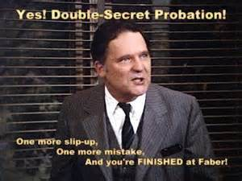

Slide 5
COLLEGES AND STUDENT BEHAVIOR
Thomas Jefferson called the problem of student discipline “…the most difficult in American education.”
Like the University of Virginia in Jefferson’s day, colleges and universities attempt to regulate behavior not just to prevent misbehavior, but also to foster a collegial environment in which students can live and learn productively.
Edward N. Stoner II. Reviewing Your Student Discipline Policy: A Project Worth the Investment. http://www.edstoner.com/uploads/UE.pdf

Slide 6
Colleges and Student Behavior
Maintain a safe and secure environment
Maintain an environment conducive to academic pursuits
Maintain the college’s image
Notes:
West Virginia University has been dethroned, and the University of Iowa has taken the top seat as the most hard-partying college in the country in the latest Princeton Review rankings.

Slide 7
COLLEGES AND STUDENT DISCIPLINARY PROCEDURES
“…a college is not a court of law and the real object of college discipline is not to ‘make the punishment fit the crime’ but …to educate the individual in the particular area where he (she) is weak.” (p.191)
“ If the failure of the spirit, which have to do with integrity, honor and respect for the rights of others can be adjusted, the failures of the mind can be more easily met.” (p. 219)
Hawkes, H. E. and Hawkes, A. L. (1945), Through a Dean’s Open Door, McGraw-Hill Publishers.

Slide 8
COLLEGES AND STUDENT CONDUCT PROCEDURES
“Unfortunately, higher education has in recent years neglected its historical commitment to building character, values, and commitment to responsible citizenship.
Blimling, G. S. and Whitt, E. J. (1999). Good Practices in Student Affairs: Principles to Foster Student Learning. American College Personnel Association.
WHY?
COURTS
FEDERAL AGENCIES
LEGISLATION

Slide 9
STRUCTURE
INFORMAL
FORMAL
APPEAL
Notes:
Informal:
Emphasize education/development—especially relating to sanctions.
Discuss exception—administrative suspension

Slide 10
DEVELOPMENTAL STUDENT CONDUCT
The student understands why the behavior was inappropriate
The student understands his/her obligations as a member of the academic community
The student understands the consequences of future misbehavior
ACPA-College Student Educators International’s Commission for Student Conduct and
Legal Issues (2010). Student Conduct Board Manual and Reference, p. 7
http://members.myacpa.org/Scripts/4Disapi.dll/store/student-conduct-board-manual-and-reference/1054/

Slide 11
DEVELOPMENTAL STUDENT CONDUCT
Meeting (Informal Hearing)
Explain purpose
Keep “informal”
Obtain Information
Decide
Sanctions
Severity of Offense
Previous disciplinary record
Attitude
Explain

Slide 12
CONTACT INFORMATION
Russ Bumba, Ed. D.
Associate Vice President for Student Services
and Research
SC Technical College System
111 Executive Center Drive
Columbia, South Carolina 29210
(803) 896-5367
bumba@sctechsystem.edu

