Slide 1
Creative inquiry
Undergraduate Research and Project-Based Learning at Greenville Technical College
New Directions in Student Development Conference | March 4, 2016 Lee Edwards, Liz Anderson, Shane Isbell & Cindy Davies

Slide 2
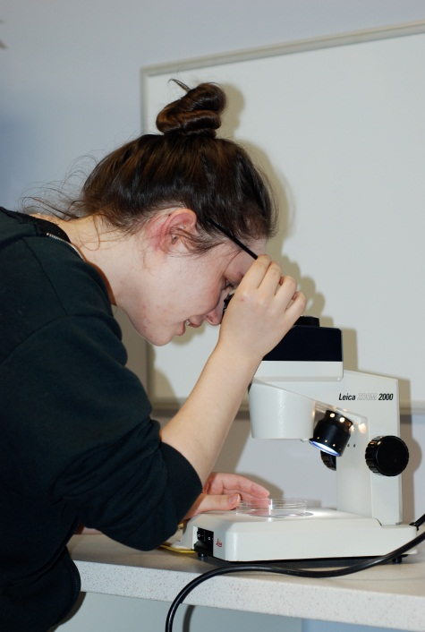
What is Creative Inquiry?
Creative Inquiry (CI) is a college-wide student opportunity that encourages curiosity and supports exploration.
Students are involved in…
faculty-driven or faculty-mentored research,
career-related research, or
problem-based learning
…for undergraduate credit!

Slide 3
How it began
Fall 2013
Formed exploratory team of faculty and support staff
Investigated programs at other institutions
Brainstormed possible topics across all college programs (makes GTC different!)
Spring 2013
Developed processes
Identified campus champions (AVP, Deans, Librarians)
Summer 2014
Sent team to community college research conference in Nebraska
Courses approved by Curriculum Committee
Courses approved by State Tech
Recruited pilot instructors
Fall 2014
First Creative Inquiry courses offered
Offered course waivers in lieu of faculty compensation
Spring 2016
Offered faculty compensation in lieu of course waivers
Planned first annual Student Scholar Showcase
Notes:
A group of instructors representing each division of Greenville Technical College met during the Fall 2013 semester to discuss the implementation of a creative inquiry program for the following year.
We proposed an initiative to provide students the opportunity to go beyond classroom instruction and get involved in faculty-driven or faculty-mentored research, career-related research, or problem-based learning.

Slide 4
What are the course options?
AHS 299 Research in the Health Sciences
BIO 299 Research in the Biological Sciences
BUS 299 Research in Business
CHM 299 Research in Chemistry
EGR 299 Applied Research in Technical Fields
HSS 298 Research in the Humanities
NUR 299 Research in Nursing
PSY 299 Research in Psychology
SOC 299 Research in Sociology

Slide 5
How does Creative Inquiry begin?
Student Decides
Join research conducted by faculty member OR Propose a project of his/her own
Faculty Agree
If instructor agrees, a research contract is drafted. Contract must be approved by Dept. Head and Dean.
CI Director Enrolls
On receipt of an approved contract, Lee Edwards enrolls student in the appropriate CI course.

Slide 6
What goes into the research contract?
Project Details
Instructor
Course number
Project title and description
Student responsibilities
Timeline
Communication plan
Expected learning outcomes
Assessment method
Resource needs
Institutional Review Board (IRB) checklist
Signatures (Faculty, Student, Dept. Head, Dean)
GTC Student Research Contract

Slide 7
Faculty Compensation
PILOT PHASE
Faculty Volunteers Student Waivers
INSTITUTIONALIZED
Faculty Bonuses Student Tuition
Effective Spring 2016,students participating in CI courses pay standard tuition rates, and faculty approved to lead the courses are compensated as follows:
$500 semester bonus for a CI course enrolling 1 to 3 students
$750 semester bonus for a CI course enrolling 4 or 5 students
CI courses may not enroll more than 5 students
CI courses may not be part of teaching load (overload only)

Slide 8
The Librarian’s Role
Librarians and Research
Creative Inquiry LibGuide
http://libguides.gvltec.edu/creativeinquiry
Scheduled Meetings

Slide 9
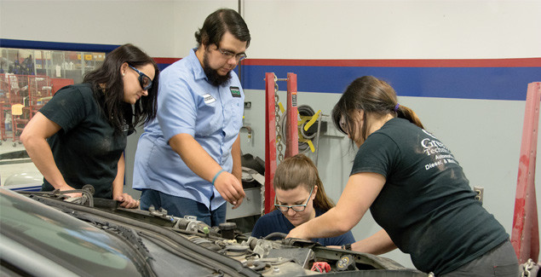
Current Projects
Eden Mays Breanna Sims Joshua Gilliam Virginia Davis
Recycled Rides
Shane Isbell
EGR 299 | Fall 2015
Photo Source: http://upstatebusinessjournal.com/wp-content/uploads/2016/01/Innovate12215_hero-635x325.jpg
Recycled Rides-National Autobody Council (NABC) Community Service Initiative

Slide 10
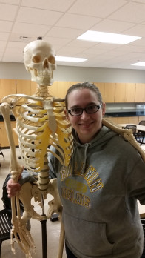
Current Projects
Rebecca Poore
Identification of Skeletal Remains
Brad Caldwell
BIO 299 | Spring 2016
“I am excited and anxious to look and learn more about skeletal remains and what they can tell me about a person.”

Slide 11
Current Projects
Leslie Brooks
Magical Realism in Latin American Literature
Chuck Baker
HSS 299 | Spring 2016
“I hope to gain experience in both a field I am passionate about and a better understanding of what will be required of me as an educator at a post-secondary institution.”

Slide 12
Past Projects
Caroline France
Dangers of the diet industry
Dr. Frank Provenzano
PSY 299 | Fall 2014
“…I can say without hesitation that I strongly recommend the Creative Inquiry program to any student who is interested in research.”

Slide 13
Past Projects
Julia Fortney
Possible links between increased academic performance and service learning
Dr. Frank Provenzano
PSY 299 | Fall 2014
“Although Greenville Tech offers many opportunities for classes, Creative Inquiry allows for the individualization of a class.”

Slide 14
Past Projects
Victoria Dover
Reproductive cycles of North American copperheads
Dr. Lee Edwards
BIO 299 | Spring 2015
“…I put my effort into finding the perfect project for my future career.”

Slide 15
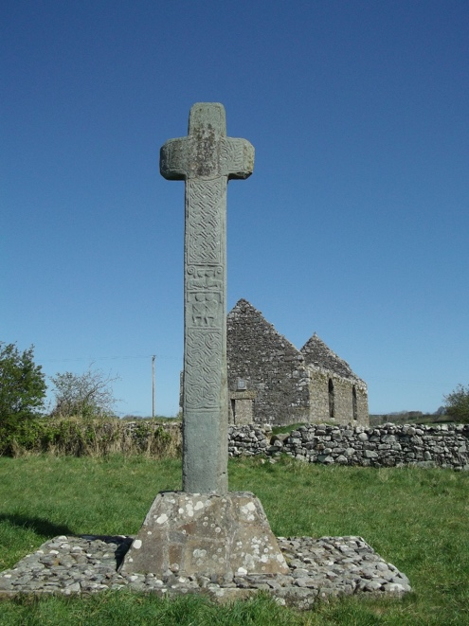
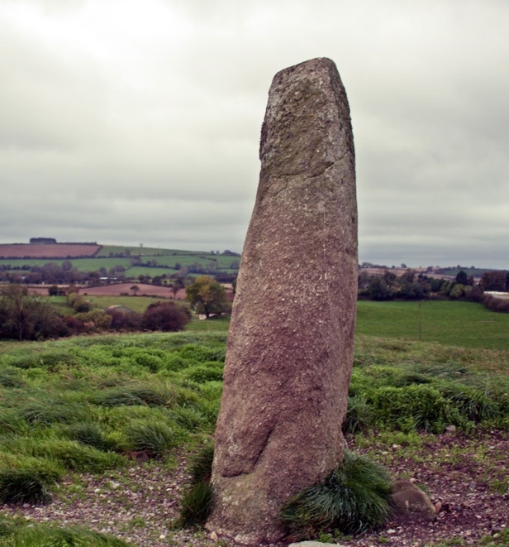
Past Projects
Lily Kincaid
The Celtic High Cross and its relation to Irish menhir
Julie McArdle
HSS 298 | Spring 2015
“It has been a great privilege to participate in the Creative Inquiry Program at Greenville Tech…”

Slide 16
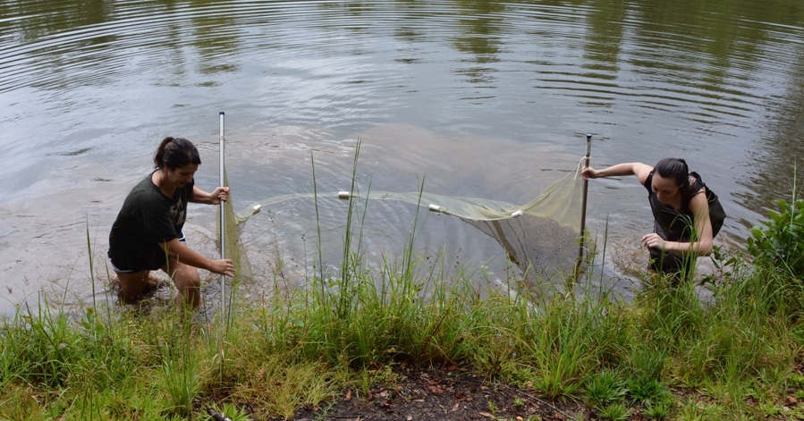
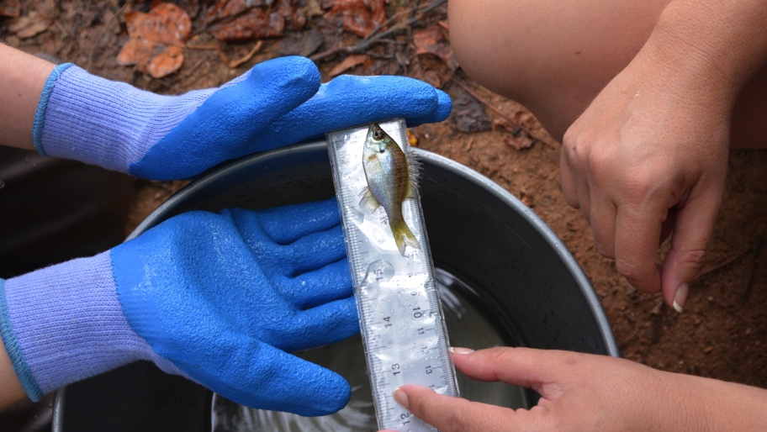
Past Projects
Hannah Groh
Inventory of Resident Fish at Brashier Campus Pond
Kathy Maples
BIO 299 | Fall 2015

Slide 17
Past Projects
Victoria Skelton
Gender biased language in art criticism
Julie McArdle
HSS 298 | Fall 2015

Slide 18
End of Semester
Students and their faculty mentor are invited to a report-out meeting.
Attended by VP of Academic Affairs, Deans from each division, and Creative Inquiry advisory committee members.
Spring 2016 semester meeting will be in April.
Notes:
Accountability
CI is drawing students into scholarly communication and part of that is the report-out process
Is part of the Student Research Contract fulfillment

Slide 19
Future Directions
Increased cooperation with:
International Education
Campus and Civic Engagement
Honors Program

Slide 21
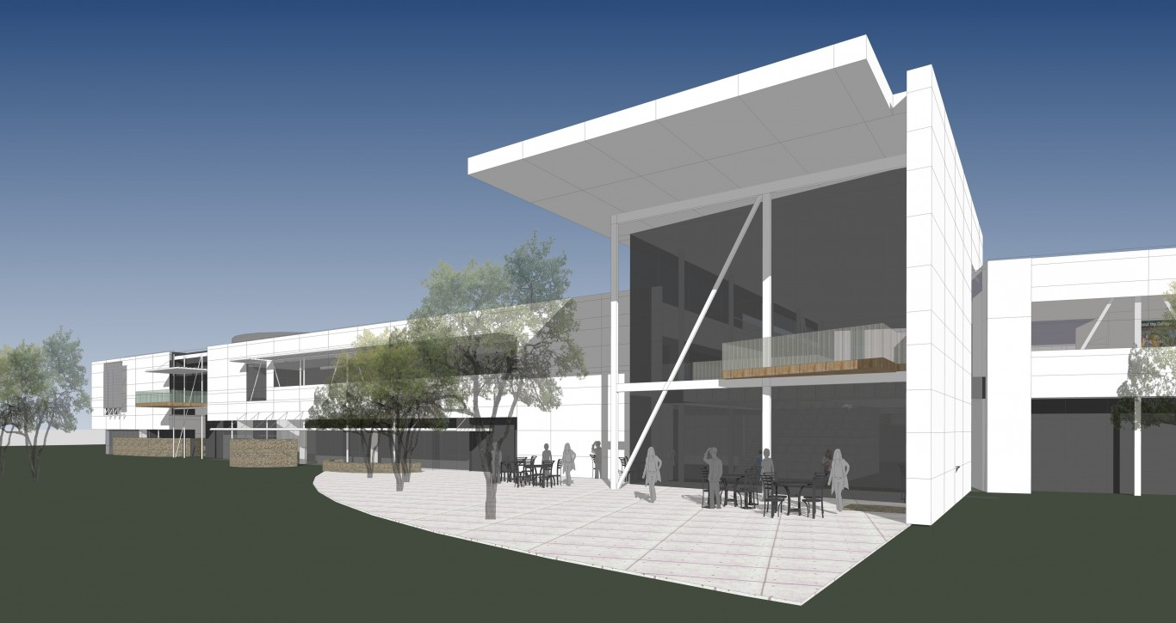
Future Directions
Center for Manufacturing Innovation

Slide 22
Stay in touch!
Greenville Tech - Creative Inquiry https://www.facebook.com/gtccreativeinquiry/?fref=ts
@GTC_CI
https://gtccreativeinquiry.wordpress.com
Lee Edwards, Ph.D.
Creative Inquiry Director Greenville Technical College Lee.Edwards@gvltec.edu (864) 250-8457

