Slide 1
New Directions in Student Development
Piedmont Technical College March 3-4, 2016

Slide 2
Who says you cannot go home again?

Slide 3
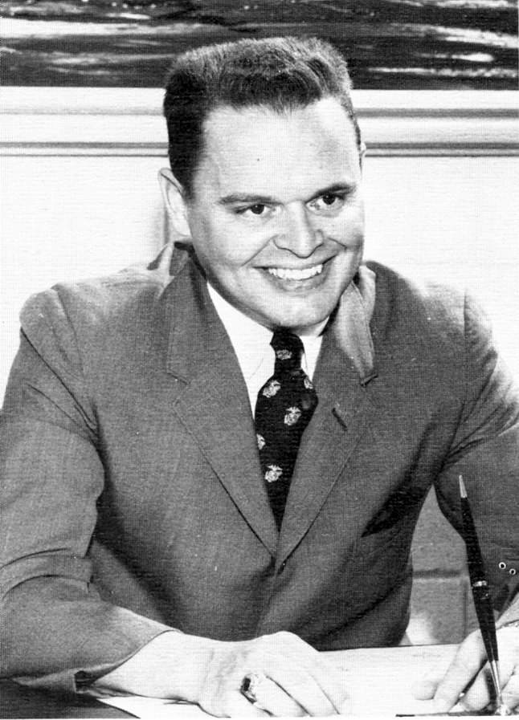

Slide 4
Four Phases of Leadership Growth
1. I didn’t know what I did not know.
2. But, I quickly discovered the things I did not know.
3. I grew and knew, and it started to show
4. Now I go because of what I know
Therefore, to lead tomorrow, learn today

Slide 5
Discovering and Developing the Leader in You
A presentation by Dr. James Hudgins
Piedmont Tech Student Affairs Conference
March 3, 2016

Slide 6
The Best of Times and the Worst of Times
Charles Dickens
The Tale of Two Cities
1859

Slide 7
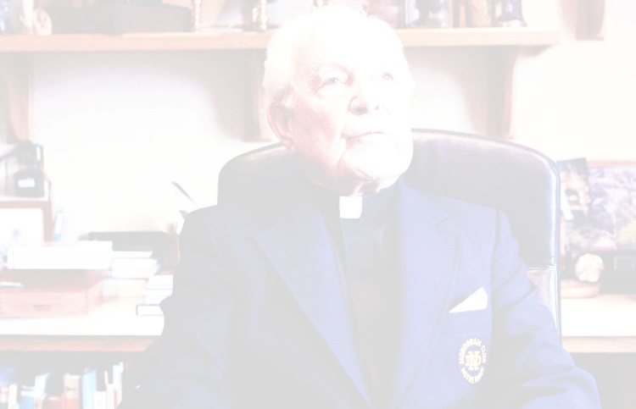
“Higher education and every other enterprise moves forward when there is good leadership; otherwise it stagnates...of course, you need money. But, if you have money and no vision, you just squander it.”
The Rev. Theodore Hesburgh
President, Notre Dame

Slide 8
Basic Assumption
The quality of leadership, more than any other single factor, determines the success or failure of an organization

Slide 9
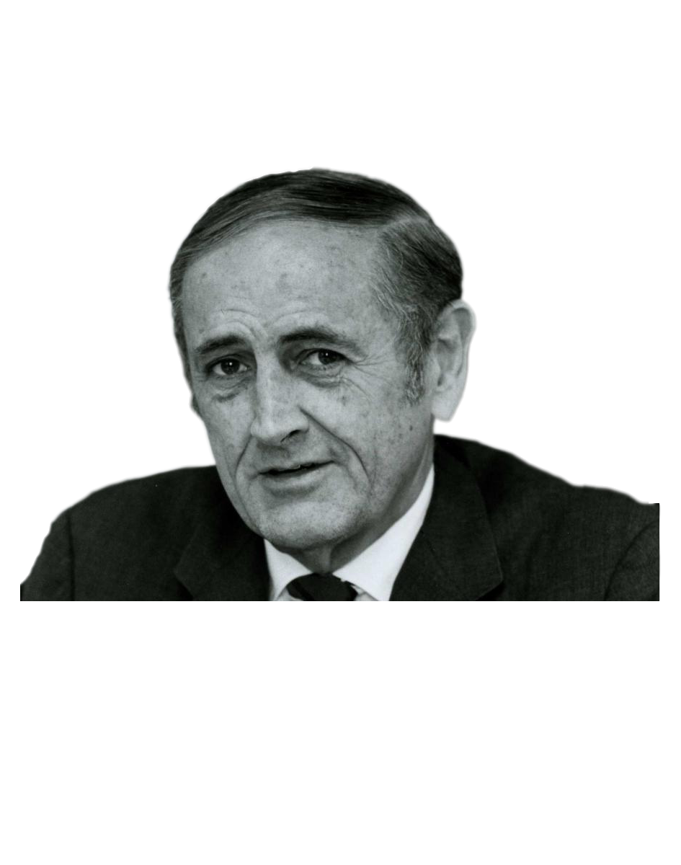
“Leadership requires major expenditures of effort and energy – more than most people care to take.”
John Gardner
Secretary of HEW

Slide 10
How much are you willing to invest in developing the leader that is within you?

Slide 11
Presentation Premises
Leaders make a difference!
Leaders make things happen!
Organization effectiveness depends on leadership!
Leaders are persons like you!
You are/can be a leader!
Ergo, there is a leader in you!

Slide 12
Let’s Begin with the

Slide 13
The Essence of Leadership
Integrity/trust
Relationships
Vision/idea
Influence/persuasion
People/teamwork

Slide 14
Where does Leadership begin?

Slide 15
Leadership begins with YOU!!!

Slide 16
Self-Discovery
Self-Development
K & P
Northouse
LEADERSHIP

Slide 17
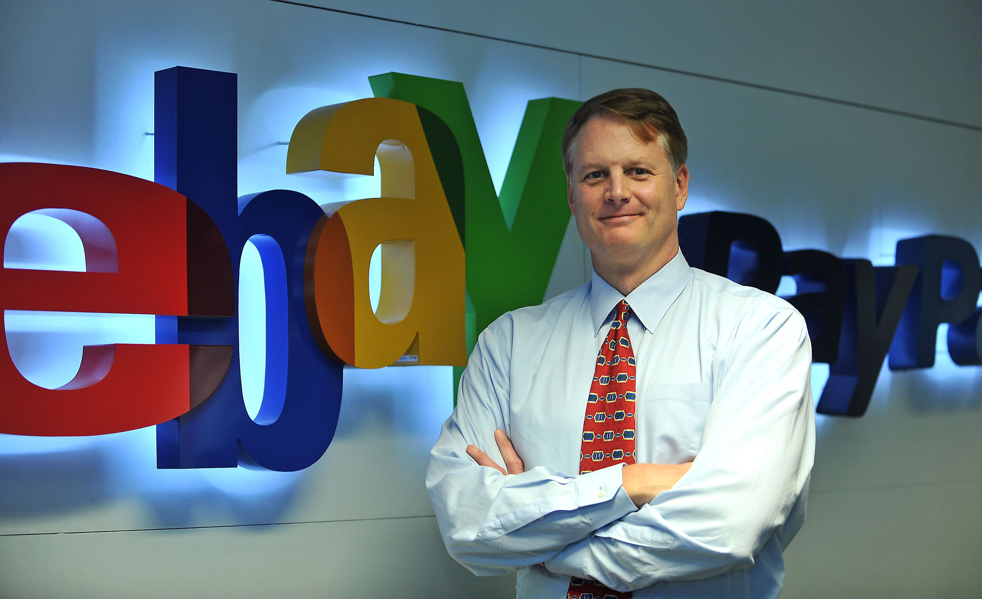
“Leadership is a journey, not a destination.
It is a marathon, not a sprint.
It is a process, not an outcome.”
John Donahoe
President of eBay

Slide 18
Since leadership begins with you, let’s explore the leader within…
YOU

Slide 19
Three Questions
Who is a leader?
What is leadership?
How do I demonstrate leadership?

Slide 20
Who is a leader?

Slide 21
Someone who has followers

Slide 22
“He who thinketh he leadeth and hath no one following is only taking a walk.”
Leadership Proverb

Slide 23
How do you get others to follow you?

Slide 24
Demonstrate Leadership!

Slide 25
What is Leadership?
Leadership is a field in the discipline of social sciences
Research on leadership began in the early 20th century
Yet, leaders have been present from the beginning of civilization
It takes place at every level of human (animal) interaction
The practices and styles of leadership have reflected time and culture

Slide 26
Theories of Leadership
Traits
Skills
Styles
Situational Leadership
Team Leadership
Transformational Leadership
Northouse Leadership

Slide 27
Five Principles of Leadership

Slide 28
Principle I : Leadership Can Be Defined

Slide 29
“There are almost as many definitions of leadership as there are persons who have attempted to define leadership.”
Handbook on Leadership
Ralph Stogdill

Slide 30
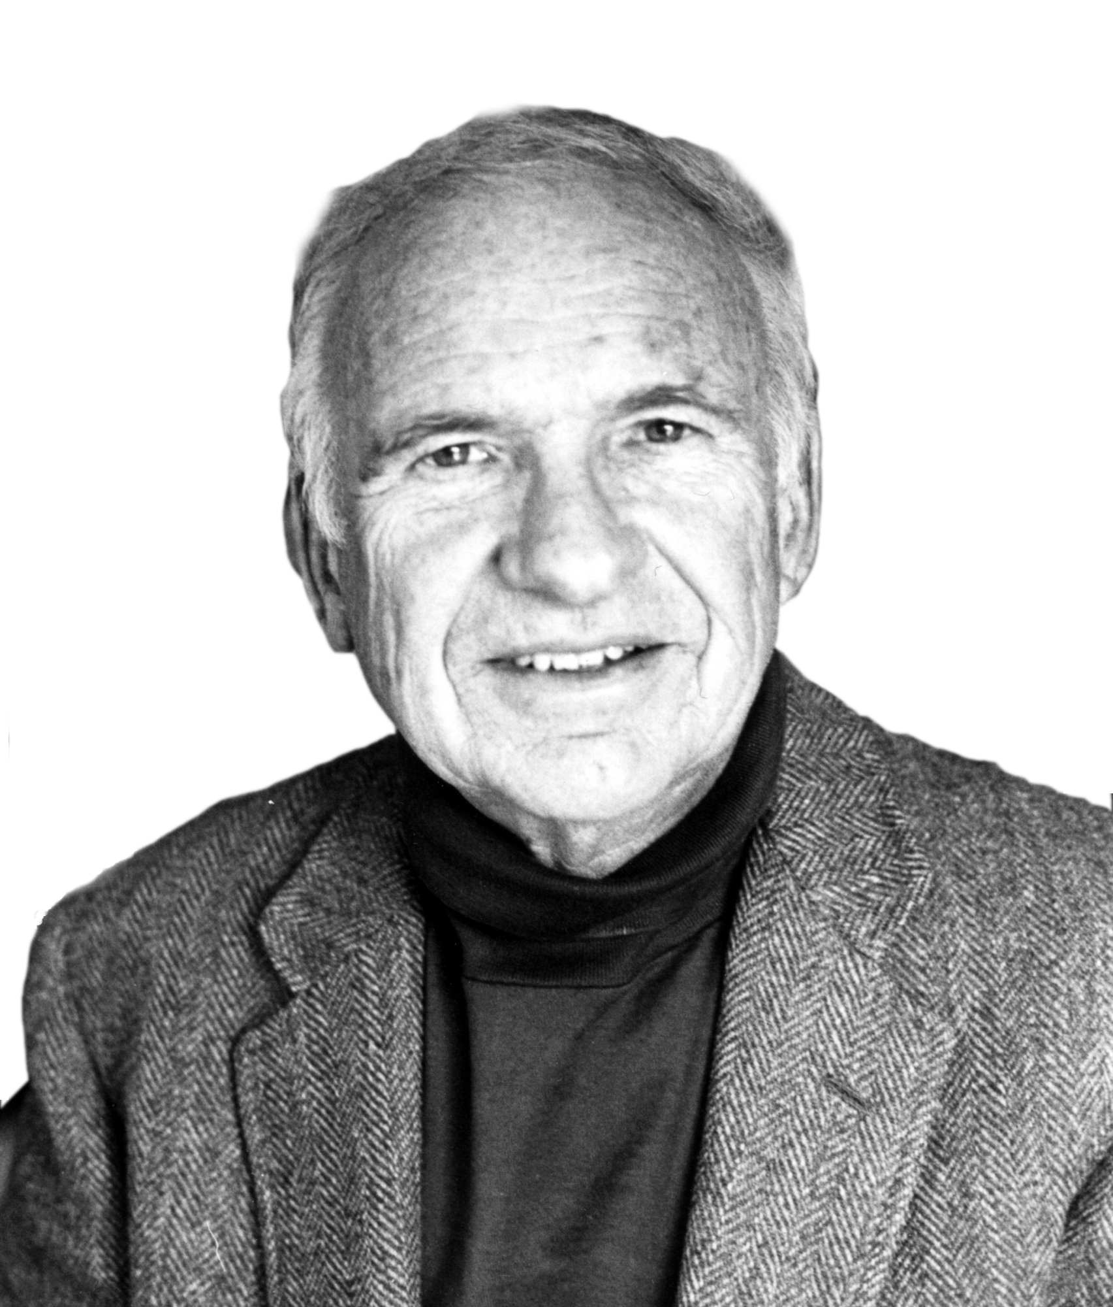
“Leadership is one of the most observed and least understood phenomena on earth.”
Leadership
James MacGregor Burns

Slide 31
“Leadership is one of the most studied and the least understood topic of any in the social sciences. Leadership is like the Abominable Snowman whose footprints are everywhere but who is nowhere to be seen.”
Leaders: Strategies for Taking Charge
Bennis & Nanus

Slide 32
“Decades of academic analysts have given us 350 definitions of leadership but no clear and unequivocal understanding exists as to what distinguishes leaders from non-leaders.”
Leaders: Strategies for Taking Charge
Bennis & Nanus

Slide 33
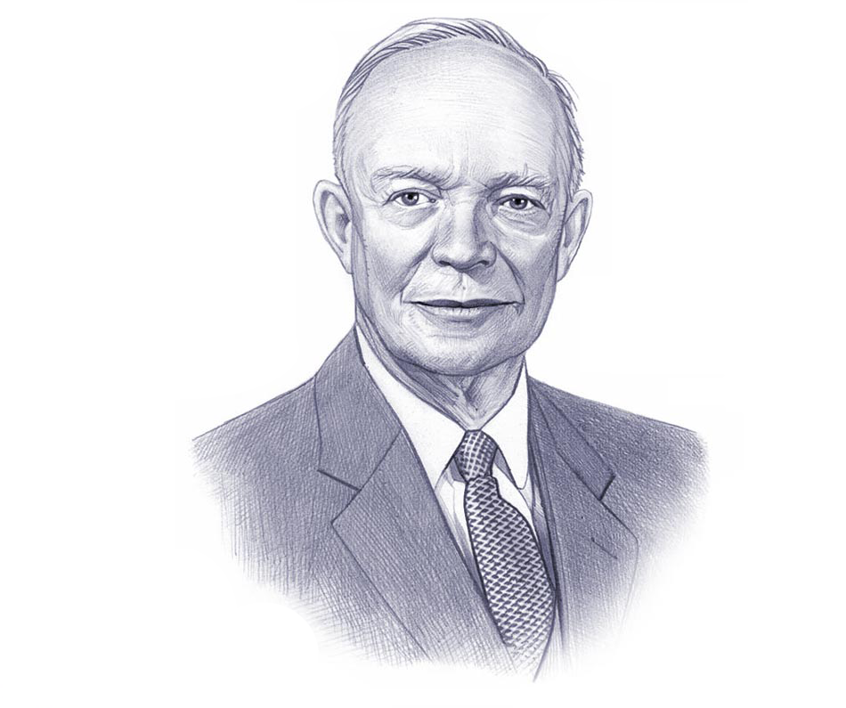
“The art of getting someone else to do something you want done because he wants to do it.”
Dwight Eisenhower

Slide 34
Leadership is the art of connecting with people
RelatRelationships

Slide 35
“Leadership is influence. That’s it! Nothing more; nothing less.”
John C. Maxwell

Slide 36
“Leadership is the process of persuasion or example by which an individual induces a group to pursue objectives held by the leader or shared by the leader and his or her followers.”
John Gardner

Slide 37
“A leader is someone you choose to follow to a place you wouldn’t go by yourself.”
Joel Barker

Slide 38
Principle II : Leadership skills (and traits?) can be developed

Slide 39
“Great leaders aren’t born, they develop.”
Top Executive Performance
Cohen and Cohen

Slide 40
“Leadership ability is not an innate characteristic of a privileged few. Leadership characteristics can be cultivated by most people.”
Dr. James Fisher

Slide 41
Two Types of Leaders
Truly dominant leaders
Those who become leaders through the upward spiral
1
Leadership
Creativity
Experience
2

Slide 42
Three Major Categories of Learning to Lead

Slide 43
Principle III : Leaders follow different avenues to positions of leadership

Slide 44
Avenues to Leadership
1
Great man (woman) theory
2
Big bang theory
3
Nepotism
4
Power
5
Expertise
6
Influence

Slide 45
Principle IV : Leaders have different styles

Slide 46
Styles of Leadership
1
Authoritative
2
Delegation
3
Negotiation
4
Consensus
5
Charisma
6
ALL OF THE ABOVE!

Slide 47
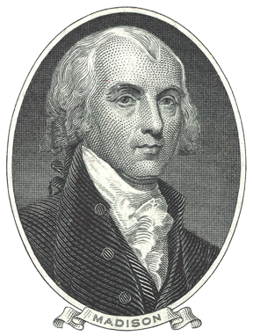
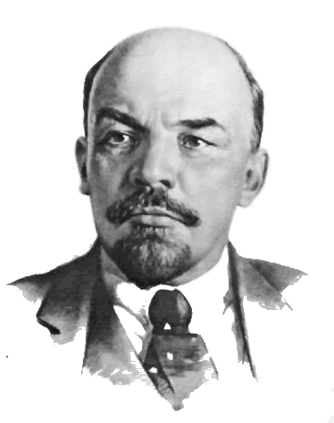
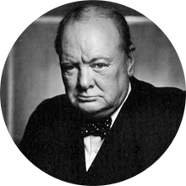
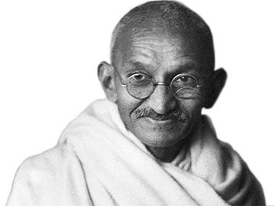
Many Kinds of Leaders
Churchill
Gandhi
Madison
Lenin
The splendidly eloquent warrior
The visionary and shrewd mobilizer of people
The brilliantly analytical designer of our political system
The cold purposeful revolutionary
Leadership, John Gardner

Slide 48
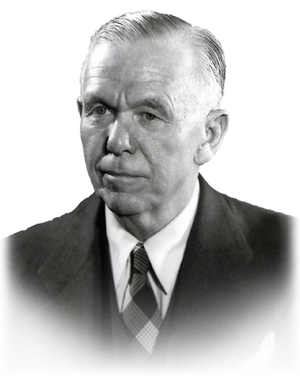
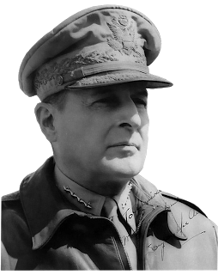
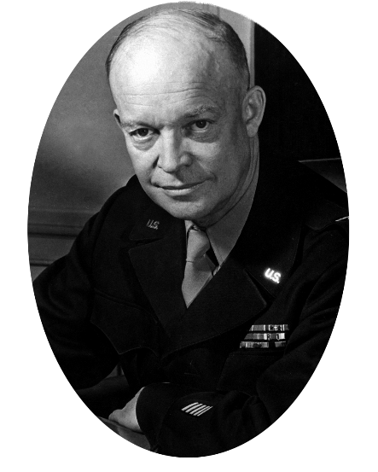
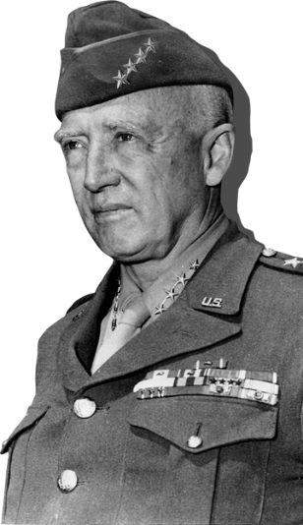
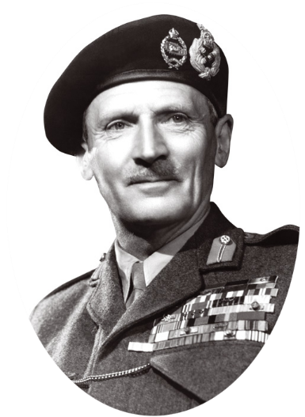
Many Styles of Military Leaders
George Marshall
Douglas MacArthur
Dwight Eisenhower
George Patton
Field Marshall Montgomery
Self-effacing, low keyed, superb judgment, inspired trust
Brilliant strategist, flamboyant, farsighted
Outstanding leader and coalition builder
Slashing, intense, combat commander
Gifted, temperamental
Leadership, John Gardner (Continued)

Slide 49
Principle V : Leaders have a few common traits

Slide 50
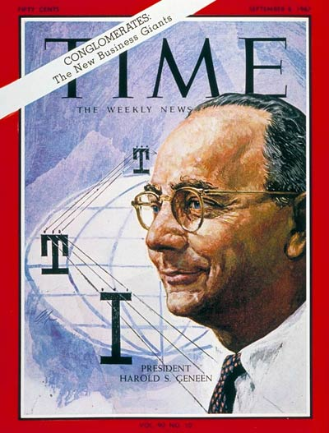
“Leadership is practiced not so much in words as in attitude and in actions.”
Harold Geneen, Telephone and Telegraph

Slide 51
“Successful leadership is not about being tough or soft, sensitive or assertive, but about a set of attributes. First and foremost it is character.”
Warren Bennis, The Characteristics of Leadership By Josephson and Hanson

Slide 52
“Don’t be impressed with charisma; look for character. A genuine leader will never exploit your emotions or your pocketbooks.”
Jesus in the Sermon on the Mountain
The Message

Slide 53
Characteristics of Superior Leaders
Honest
Competent
Forward-looking
Intelligent
Inspiring
83%
67%
Credibility
62%
58%
The Leadership Challenge, Kouzes and Posner
43%

Slide 54
The Globe Project
The project was a cross-cultural study of leadership in 62 cultures in 1999 by 170 social scientists to determine the extent to which cultures have a similar belief about effective leaders.

Slide 55
GLOBE Project Results
1
Integrity – honest, trustworthy, just
2
Visionary – has foresight, plans ahead
3
Inspirational – positive, dynamic
4
Decisive – effective bargainer, win/win
5
Team Integrator
6
Administrative Skills

Slide 56
The Leadership Lid
“You will never be more successful than your ability to lead or influence others.”
John Maxwell

Slide 57
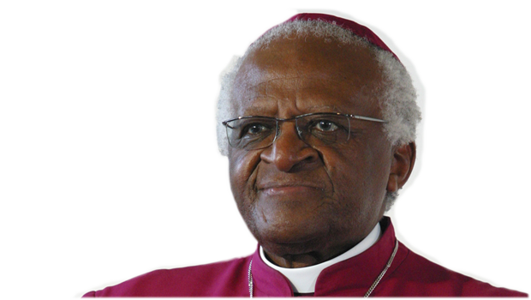
As a young man, Desmond Tutu, after observing the plight of his people asked his minister, “Why doesn’t God do something?” The minister replied, “He has, he created you!”
Desmond Tutu became the first black Anglican Bishop and led his nation in a peaceful transition away from apartheid

Slide 58
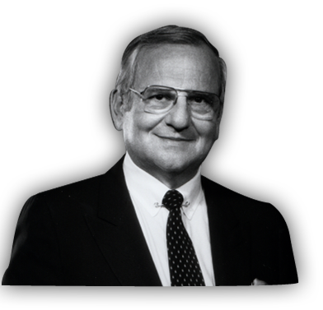
“Lead, follow, or get out of the way!”
Lee Iacocca

Slide 59
Let’s End Where We Began

Slide 60
The Essence of Leadership
Integrity/trust
Relationships
Vision/idea
Influence/persuasion
People/teamwork

