Slide 1
Virtual Queue Management… Takes the Wait Out of the Waiting Room
Presenters:
Allison Keck and Donnie Tomlin
Financial Aid Officer and Operations Manager
Greenville Technical College, Greenville SC
Notes:
Abstract
The Office of Financial Aid and Veteran’s Affairs needed a system to manage the flow of students.

Slide 2
Background
GTC is a public, two year college with four campuses
Student population is around 15,000
130 curriculum programs are offered
Financial Aid and Veteran Affairs staff 26 full and part time employees
Notes:
Programs - Arts and Sciences, Business and Public Service, Health Sciences and Nursing, and Technology

Slide 3
Problem/Initiative
Old process
manually write down student’s names on a list that officers would call them from
Lobby was full of students and parents just sitting and waiting
Led to angry, hostile students and very low customer satisfaction
Notes:
VP pf Financial hired a Project Manager to come in to see what we needed to improve the office flow.
During non-peak times, officers working from their offices were unaware of the traffic at the windows and this lead to longer than necessary wait times. There are also periods of extremely heavy traffic where students would have to wait several hours in the lobby to be seen by a Financial Aid Officer. In fall of 2012, the wait time exceeded 4 hours and the waiting list had to be cut off as early as 11:00 a.m. to be able to service all students by the close of business. They didn’t want to leave because they didn’t want to miss their spot. Some would miss lunch to sit in the lobby and wait.
Show As is(was) flowchart

Slide 4
Design
Small design team was formed
Low cost, students could understand process and quick start time
Team examined several commercial options
weighing the pros and cons of each system
Notes:
small design team was organized from members of the Financial Aid and Veteran’s Affairs Office to investigate and carry out the implementation of queue management system
Things we were keeping in mind Low cost, students could understand process and quick start time
The team examined several commercial options and the possibility of a “home-grown” system. After weighing the pros and cons of each system, it was decided to purchase a system called QLess.
Show to be Flow chart

Slide 5
Implementation
Starting the end of May with staff
Mid June with students entering themselves into the system
Gave us time to work out Queue names and Market to students
Rush time is end of July until end of August
Communication was still an issue
Notes:
One of the best things we did was start it early. By starting this the end of May; we had 2 full months to work out some of the queue names and how we would work students needing to see specific agents (starting the internal queue) before the rush of the fall season. The design team had set a target date of June 17, 2013 to have students begin using QLess self-service, but started earlier, around June 11, having the students enter themselves in the queue through computers set up in our building or in the computer lab.

Slide 6
How to communicate with Staff?
Notes:
During the implementation, the design team realized the need for a better communication solution to contact agents who had students waiting to see them. This challenge was addressed by implementing an instant messenger system. This was a low cost solution, as it was actually part of our phone system that had never been implemented. IT just had to set up for each staff member. Instant messenger allows agents to communicate with other staff members without having to leave their office with students in there. It is also used to notify staff that a student has been placed in the internal queue for them and receive a quick confirmation that they are available. This feature enables staff to tell when our agents are busy on the phones or in a meeting without having to send full emails.

Slide 7
Getting the word out…
IT Staff placed icons on all PC in computer labs on campus
Marketing advertised June
business card sized handouts, stickers on all orientation packets, window clings on doors around campus, and presence on the website and Facebook
Notes:
The design team worked with College Marketing and QLess to craft the messages that would be sent to students and design the kiosk and monitor appearances. The marketing department also created a campaign to advertise this new system which was rolled out during the late June through early July timeframe. The campaign included business card sized handouts, stickers on all orientation packets, window clings on doors around campus, and presence on the website and Facebook. All of these materials included a QR code that linked to the Greenville Tech QLess kiosk. They also worked with our IT staff to get QLess icons loaded on all machines in the computer labs on campus

Slide 8
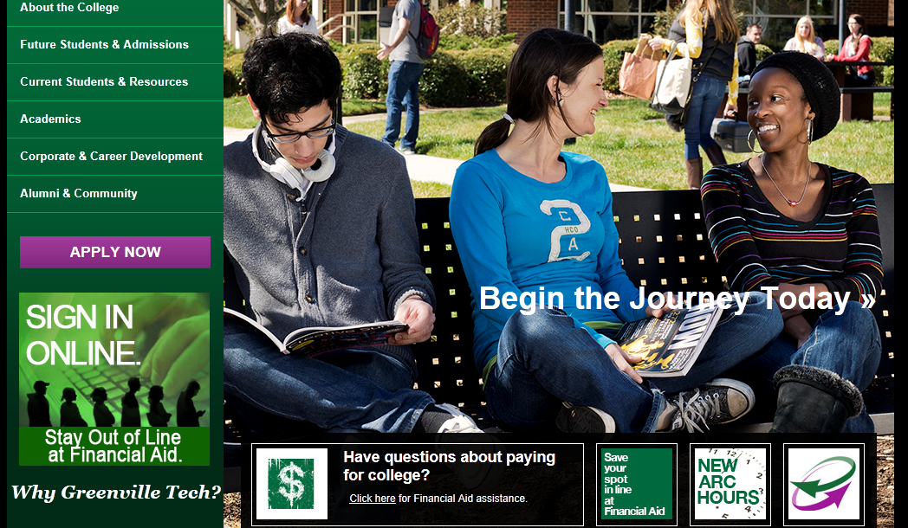
Marketing on website

Slide 9
Benefits
Student satisfaction has been the greatest benefit
Staff improvement
Holds everyone accountable
Time Management
Notes:
Another benefit of this best practice has been a dramatic improvement in the performance of some our personnel. The system shows us how many students each staff member serves. We can pull reports the next day to determine the efficiency of each agent. The system holds everyone accountable for their job. One employee who was written up for sub-standard performance last year has turned into a star performer this year. Even others, who traditionally are lower volume performers, have closed the gap due to the accountability this tool provides.

Slide 10
Service ability
Notes:
Overall, the office has increased efficiency in the volume of students seen by over 43% during the July through August peak season. The total volume of students serviced during that period increased from 9,598 in 2012 to 13,750 during the same period in 2013.

Slide 11
Students in line

Slide 12
Text Message

Slide 13
Student Feedback
“I love the text set up you have. And your staff is wonderful!”
“No waiting time. My experience was very positive and helpful. Thank you.”
“The text was helpful and saved from confusion and the noise of bells. Thank you.”
“I love this new service! Very effective and useful! Overall extremely pleased.”

Slide 14
Tweet

Slide 15
Reports
Wait time, student time spent with officers, number of students abandoning line, etc.
How many students each officer assist is very beneficial. It shows each day how may students each officer helped.
Helps with scheduling and accountability
Notes:
provides reports on how we are doing – wait time, student time spent with officers, number of students abandoning line, etc.

Slide 16
Campus wide
We have implemented the system in Admissions Office and soon to implement at the Satellite Campuses
Virtual Management system and Instant Messenger
Notes:
Students love it so much they want it in every office.

Slide 17
Retrospect
When to turn on the queue each day
How long to give a student to arrive
Creation of an internal queue
allows us to manage students who need to see a specific employee
Notes:
Once the system was up and running, there was some tweaking of things like when to turn on the queue each day for students to begin logging in,
how long to give a student to arrive before we allow them to be moved to “expired”,
and the creation of an internal queue.
The internal queue allows us to manage students who need to see a specific employee. This has worked very well.

Slide 18
Entering into the system
Notes:
Log into Qless
https://merchant.qless.com/qless/merchant/beta/

Slide 19
Questions??

