Slide 1
BEST PRACTICES IN OCR COMPLIANCE
March 6, 2020

Slide 2
AGENDA
Introductions
Overview of OCR Methods of Administration
Desktop Review
Site Visits
Common Findings
Best Practices
Questions

Slide 3
Executive VP
Dr. Hope Rivers (State-Wide Initiatives)
RESEARCH & SPECIAL PROJECTS
Motorcycle Education
Teaching and Learning Tuesdays
Professional Development Institutes
Institutional Effectiveness
CURRICULUM, INSTRUCTION & RESEARCH Dr. Rosline Sumpter
Course/Program Development
Program Evaluation
Peer Groups
Grants Management
STUDENT SERVICES Dr. Eric Brown
Student Services
Methods of Administration
Service Learning Peer Groups
President Dr. Tim Hardee
ACADEMIC PARTNERSHIPS Dr. Aimeé Carter
Articulation and Transfer
Dual Enrollment
ACADEMIC & PROGRAM COMPLIANCE
Ms. Lane Goodwin
Compliance
Web Accessibility
Methods of Administration

Slide 4
VISION STATEMENT
The Division will be known for bold, innovative, and sustainable practices that promote student success.

Slide 5
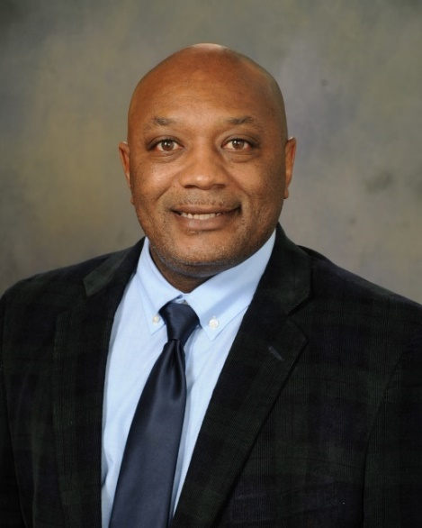
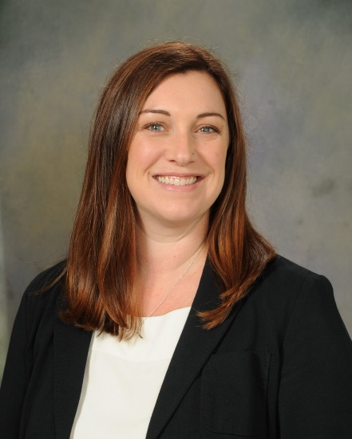
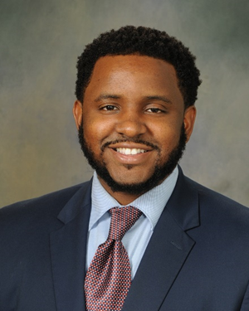
MEET YOUR PRESENTERS
Dr. Eric Brown
Associate Vice President,
Student Affairs
Lane Goodwin
Director of Academic and Program Compliance
Austin Floyd
Program Coordinator, Student Affairs

Slide 6
WHAT IS OCR’S METHODS OF ADMINISTRATION (MOA)?
Partnership
Equity
Risk Management

Slide 7
LEGAL BASIS FOR MOA
Title VI
Title IX
Section 504

Slide 8
TARGETING PLANS
Race
Institutional and Programmatic
Student and Faculty/Staff
Gender
Institutional and Programmatic
Student and Faculty/Staff
OCR Case Activity
Length of Time Since Last Visit

Slide 9
DATES OF LAST ON-SITE MOA VISITS
Aiken 2011
Central Carolina 2015
Denmark 2015
Florence-Darlington 2019
Greenville 2012
Horry-Georgetown 2009
Midlands 2010 (scheduled for Spring 2020)
Northeastern 2017
Orangeburg-Calhoun 2016
Piedmont 2019
Spartanburg 2016
Lowcountry 2018
Tri-County 2017
Trident 2014
Williamsburg 2018
York 2013

Slide 10
DESKTOP REVIEWS AND ON-SITE VISITS
Review Team: Student Affairs, Facilities, and Human Resources
What do we review?
Criterion data
Publications (catalogs, website, handbooks, program-specific marketing materials, social media sites)
Job postings, externship agreements, and apprenticeship contracts
College job postings and employment applications

Slide 11
ON-SITE VISITS
Interviews
Human Resources
Facilities Accessibility
Cooperation is key

Slide 12
AFTER THE ON-SITE VISIT
Exit Interview
Voluntary Compliance Plan (VCP)
Confirmation of VCP Completion

Slide 13
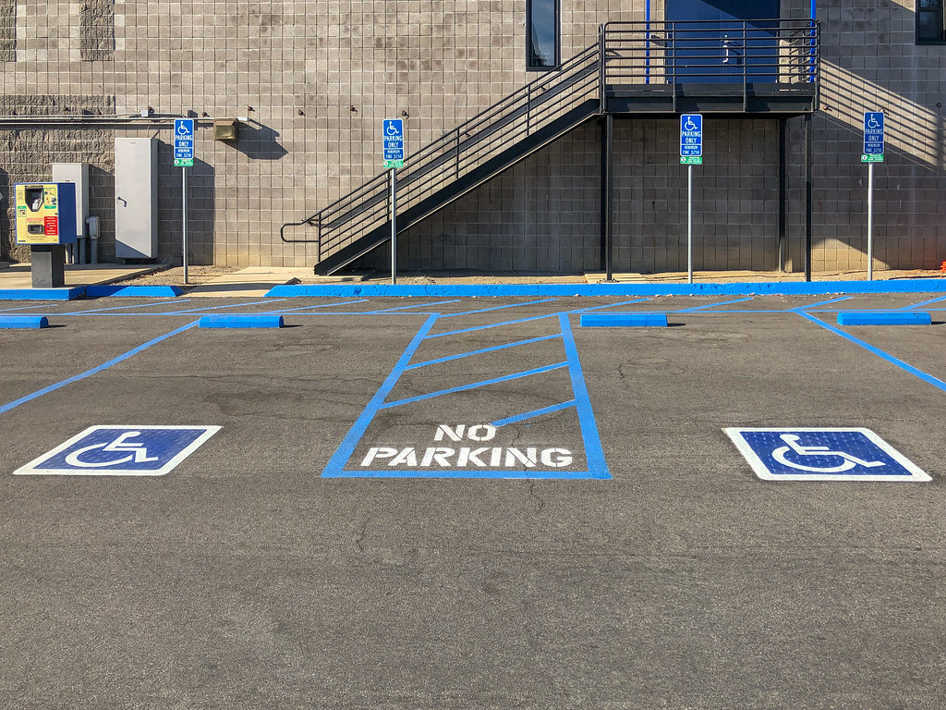
COMMON FINDINGS
College policies that conflict with system procedures or OCR
Incomplete non-discrimination notices
Minor facilities issues

Slide 14
ANNUAL NON-DISCRIMINATION NOTICES
Annual Notice:
Must be provided annually in major publications such as the student catalog, handbook, and college website
Includes brief summary of program offerings and admission criteria or be location in proximity to this information
Includes contact information for ADA/Section 504 and Title IX Coordinators

Slide 15
CONTINUOUS NON-DISCRIMINATION NOTICES
Continuous Notice:
Must be available on the college’s homepage or by one link from the home page
Must be included in recruitment and marketing materials in addition to major publications
Includes contact information for ADA/Section 504 and Title IX Coordinators

Slide 16
SAMPLE NON-DISCRIMINATION NOTICE
The (Name of Institution) does not discriminate on the basis of race, color, national origin, sex, disability, or age in its admissions policies, programs, activities, or employment practices. The following person has been designated to handle inquiries regarding the non-discrimination policies:
Name and/or Position Title*
Address
Telephone No.
Email address
*May list multiple people/positions when more than one official has been designated to coordinate civil rights compliance (ex. one for Section 504 and one for Title IX)

Slide 17
NON-DISCRIMINATION NOTICES RESOURCE
For further guidance, reference OCR’s Notice of Non-Discrimination brochure:
https://www2.ed.gov/about/offices/list/ocr/docs/nondisc.html

Slide 18
OCR INVESTIGATIONS
Institutions should include contact information for OCR in their grievance policy
Students may file a grievance with OCR at any time
OCR may refer the complaint back to appropriate state agency or open an investigation
OCR may conduct a data request, schedule interviews, and/or do an on-site visit.
OCR case activity may increase likelihood of MOA review

Slide 19
HOW SCTCS CAN HELP
Guidance
Technical assistance visits
Training

Slide 20
QUESTIONS?

Slide 21
CONTACT INFORMATION
DR. ERIC BROWN
Associate Vice President for Student Affairs and Chief Student Services Officer
803.896.5367 (w)
browne@sctechsystem.edu
LANE GOODWIN
Director of Academic and Program Compliance
803.896.5266 (w) goodwinl@sctechsystem.edu
AUSTIN FLOYD
Program Coordinator, Student Affairs
803.896.7792 (w) floydau@sctechsystem.edu

