Slide 1
Come set Your PLATE Know Yourself to Serve Others
Presenter: Cindy L. Trimmier-Lee
Life.Live.Learn
ctrimmi2@gmail.com
Know that each of us holds a beauty and a gift to share

Slide 2
PLATE (Prepare -Lead-Attend-Think -Evaluate)
The objectives is to learn to care for yourselves.
Manage the day in day out of serving others.
Learn few techniques and fun ways to manage what comes with being in the forefront of serving.
See when we take a look at what we do continually we find out what and where our values are.
“Be intentional and choose to envision a life of significance, possibility, and impact.” ― Tony Dungy,

Slide 3
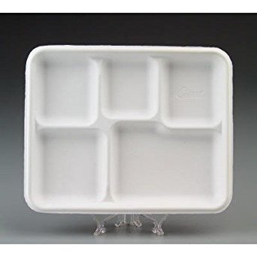
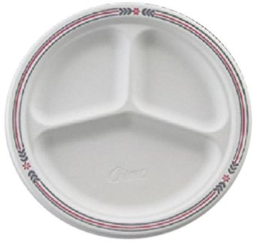
What type of plate are you? Activity 1 – Introduce YOUR self / One Word that describe You
Fill it by putting these few things in it: Faith, Job, Spouse , Kids, Family, Friends, Hobbies, You and Free Time

Slide 4
Think Out Side the Box – Plate Activity - 2
Faith (Prepare / Lead)
You
Spouse
Kids
Family
Friends
Hobbies
Job
1.Sand Box (Attend / Think )
2. Read between the lines
3. Crossing
4. Tri-cycle
5. 3 degrees below 0
6. Circle under eyes 9. Pair of Dice
7. 6 feet under 10. Fork in the Road
8. Multiplication

Slide 5
Person of Honor
I am a man or woman of honor.
I am unique, one of a kind, different, set apart for something special.
I don’t let past failures decide my future or my actions.
I respect myself first so then I can respect others.
I choose to be a leader that others can follow.
I know what I say matter, counts and creates.
I know that whatever action I take there is a reaction good or bad.
I will always choose the most excellent of good.
For I am unique one of a kind, different, set apart for something special.
I ________________________pledge today on _______________ to always be the best I can be
and
If I need help I will ask for it, in this I am made truly strong.
CTLee
My goal is to get you to think about you today !

Slide 6
SWOT
S = Strength (Stand)
W=Weakness (Worth/ willing)
O= Opportunities (Open )
T- Threats (Think out side the box )
Change your thinking!!!
Its not always how you start but how well you finish and that it continues on when you are gone…

Slide 7
Stop saying these 3 things No time - Too late -too old
Get present in the moment and ask Yourself what is important this very second.
Greg Mckeown

Slide 8
Who You are
Be a Choice
and not an option
YOU ARE NOT BORN A WINNER OR A LOSER YOU ARE BORN A CHOOSER
What YOU say about Yourself
What YOU Think About Yourself
What YOU Receive from others
By this set Your Vision –Integrity – Compassion

Slide 9
Disconnect ---- please !!! – phones, text mESSages, snap chat, twitter, e-mail – etc.
Three deep breaths: one to relax you, second to get a fresh look at things, third new soundness WHY???????????????
Mediate or think before you respond or act : emotional control (thought, words and action) seeing our words tend to lead us good or bad.
Life and Death in the tongue ( how we say something)
Listening: Truly forms bonds and questions
Questions: To ask /develop thoughts that cause purpose
Purpose : Live with it in mind causes one to really take action they can enjoy.
( Your Purpose the one You were designed for)

Slide 10
DoES what you say line up with what you do set the standard
You set them for you
Set them limitlessly
What is your standard?
You must set It.
So what opposes You?
Good – Best – Why Not Excellent

Slide 11
I need you to learn this word NO
No is a powerful word, to me it’s the single most powerful word in the English language said clearly, strongly and with enough frequency and force ; it can altar the course of history.
Shonda Rimes.

Slide 12
Life Skills To Grow ones worth Evaluate Oneself
Know your faith principals
Know when to say enough is enough for and about anything
Can you hold and start a conversation
Can you properly introduce yourself
Can you dress properly for anything (function)
Can you be alone and be okay
Can you do for yourself
Can you properly ask for things you need: a raise, job, time off, money etc.
Know Your Value is not in things
Share your gifts and add value to others
Can you put yourself first /then others
Can you agree to disagree truly and mean it
Take care of yourself Spirit, Soul and Body
Set, short, mid range and long term goals to reach
Love at all times no matter what
Be a true good friend loves at all times, will tell you the truth, want leave you when you need them and forgive you. Will do the best for you.
Net Worth is in the small things, time, love
Learn something new
Health relationships
Always stand on Truth

Slide 13
Success -The achievement of something .. not for others but for ones self that the results effect others
S = someone or something
U = understanding / unrestrained
C = carefully ( thinking it out)
C = Considering ( all that it takes)
E = Enough ( count the cost)
S = Support ( others with you)
S = Strength / someone else

Slide 14
Will you do It
I have been impressed with urgency of doing
Knowing is not enough
We must apply
Being willing is not enough
We Must Do ………Leonardo da Vinci

Slide 15
tap
THINK
ACT
PLAN
Taking CARE OF YOU -Make a Plan –Follow Through – Take Breaks
Know Things Will Get Done Even If You Don’t Do Them!!!
DO THIS
Because we all want honor, respect, love to be protected, provided for.
Love what You do, be your best at what You do, it want be like work and do it well and give it away so much so others will want IT!

Slide 16
THAT YOU MAY ENJOY THE SUNSET

Slide 17
ACTIVITY
CHOOSE ONE HOW MANY WORDS CAN YOU GET FROM OVERWHLEMED?
CARROT Animal Personality Test
EGG
COFFEE BEAN
BUBBLE
COTTON BALL
SEED

