Slide 1
“Seeing” Our Students through the Correct Lens
Crystal Ratliff
Dean, Student Success & Retention

Slide 2
Session Goals
Identify why is it important to know and understand our students.
Identify barriers that impede student success.
Review the ways ATC is helping students be successful.
Notes:
We are going to talk today about demogaphiacs, any type of descriptor is not meant not have a negative connotation or insinuate that students with this background cannot be successful, we know they are higher risk of failure or attrition

Slide 3
Are we out of focus?
Notes:
Priorities wrong, have we forgotten about our customer, our students, our commitment to improve our communities?

Slide 4
Are we too far away from the subject?

Slide 5
Are we too close to the subject?

Slide 6
Maybe our lens is dirty…

Slide 7
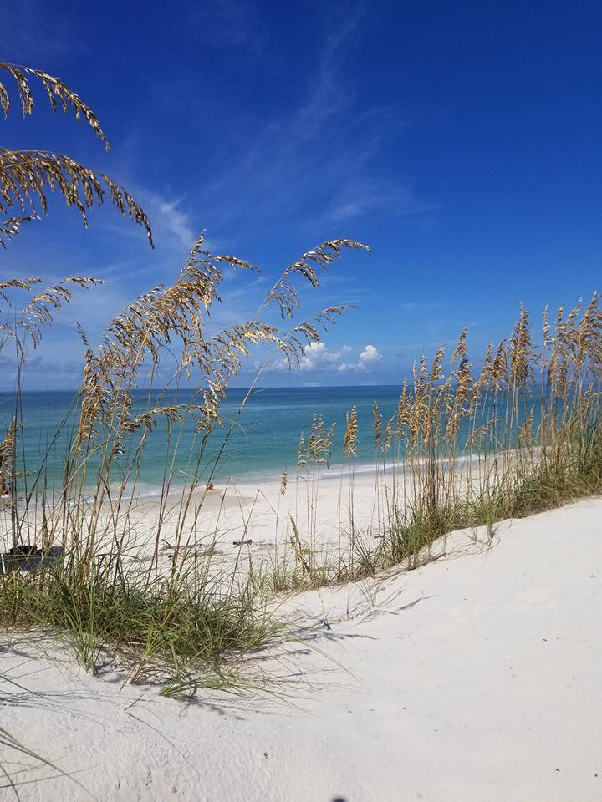
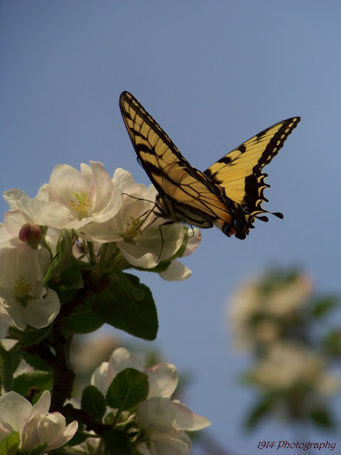
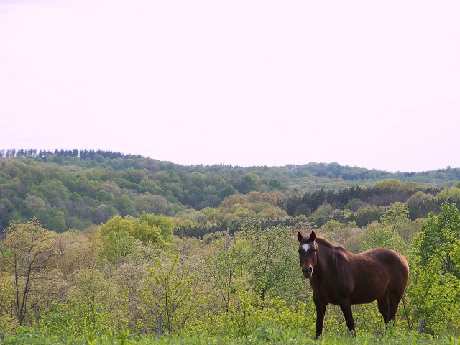
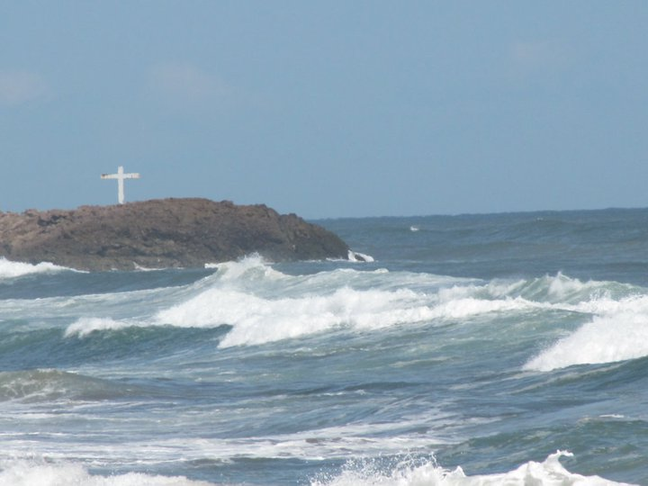
To get the perfect picture, we need the proper lens..

Slide 8
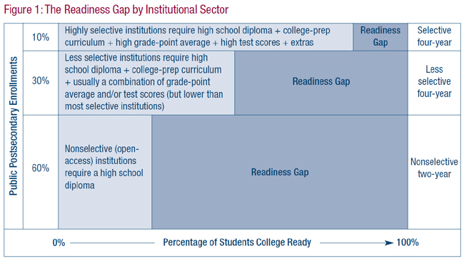
First – Our field
Research
Trends
Best Practices
National Data
Notes:
Photography!!!!
Current research and “hot” topics are wrap around services - mental health, drug rehab, food insecurity, homelessness and ensuring students feel they are part of the campus community

Slide 9
Second - our community…
Wide-Angle lens
Aiken County School District – 24,000 students
9.1% or 2,184 ESL
29.7% or 7,128 Food Stamp/SNAP Benefits
23.7% or 5,6881Families Below Poverty Level
42% or 10,080 Single Parent Household
Other Factors to Consider:
Population & Economic Growth
Local Initiatives, Needs, Focus Groups
Other Educational Programs
National Center for Educational Statistics https://nces.ed.gov/Programs/Edge/ACSDashboard/4500720
Notes:
Other - mention Christ Central - all look different have to know who is your community, multiple counties? One county like us?

Slide 10
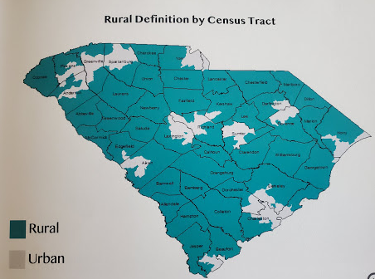
our community Cont’d…
Worst of Rural SC
High Poverty High Road Fatality Rate Low/Poor Birth Outcomes High STD Rates High Obesity Rate High Rates of Heart Disease High Rates of Cancer Low/Poor Exercise Opportunities
www.census.gov
South Carolina Rural Health Plan, 2017, pgs. 29 & 32
Notes:
Have to have a baseline understanding

Slide 11
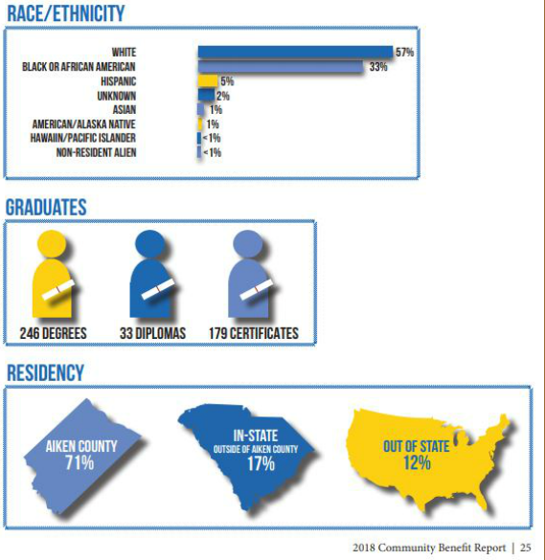
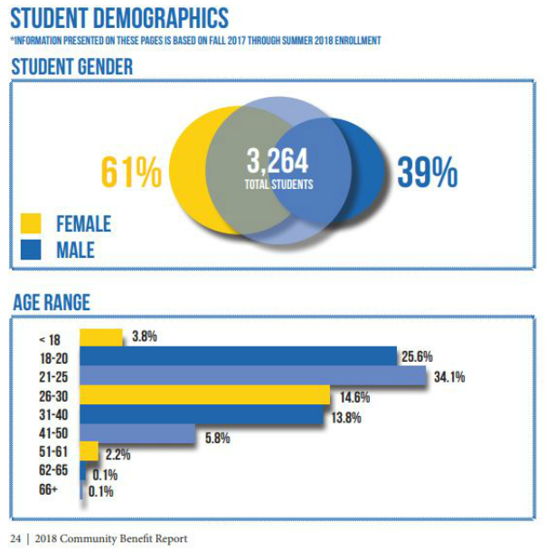
Third - our institution…
Assess our Institutions
Why do students enroll and not attend?
What happens to those who apply, are accepted and do not enroll?
Semester W & WFs
Ask WHY?
Pell = 50%
Standard lens
ATC 2018 Community Benefit Report
National Center for Educational Statistics/IPEDS

Slide 12
Fourth – Our Students
Macro lens

Slide 13
Poverty….
Knowledge of Hidden Rules
Mental/Cognitive Skills
Emotional
Motivational/Persistence
Integrity/Trust
Physical
Spiritual
Language
Relationships/Role Models
Support Systems
Financial
Situational vs. Generational
Urban & Rural Poverty
Similar but different
Becker, K., Krodel, K., & Tucker, B. (2009). Understanding and engaging under-resourced college students: A fresh look at economic class and its influence on teaching and learning in higher education. Highland, TX: Aha! Process.

Slide 14
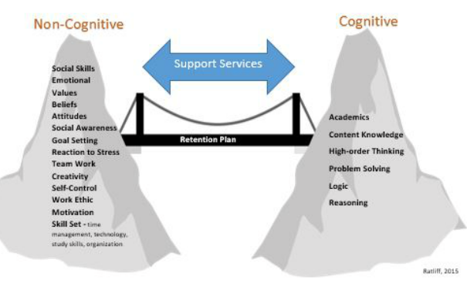
Holistic Approach

Slide 15
Putting it into practice Breaking down the barriers!

Slide 16
Tutoring
30 Tutors
21+ Subjects
Supplemental Instruction (SI) Program

Slide 18
Developmental Courses
ENG 031, 032 | MAT 031 & 032 | COL 103
RDG 031, 032
RWR 032 | MAT 032
Transitional Studies Program
Supplemental Instruction (SI) Tutoring Academic Coaching
Soft-skills Assessment 3 week Intervention Assessments

Slide 19
Green, Yellow, Red Concept…
R, RFA, RA, RP

Slide 20
Notes:
Why did we do what we did. All manual tracking

Slide 21
Green, Yellow, Red Concept…
R, RFA, RA, RP

Slide 22
LMS Retention Components

Slide 24
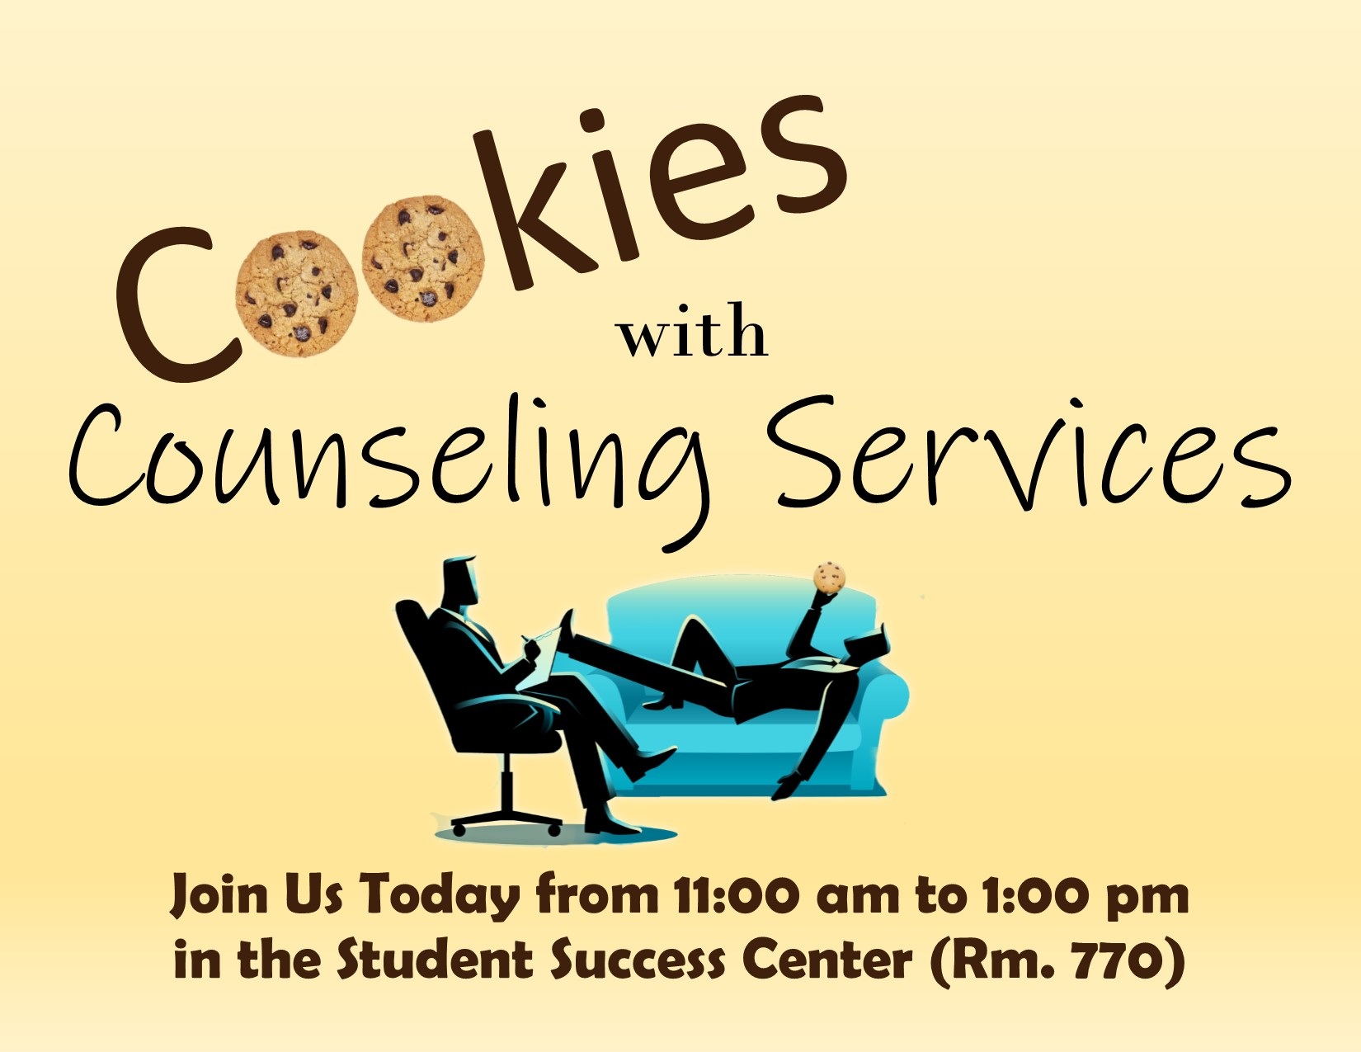
How?

Slide 25
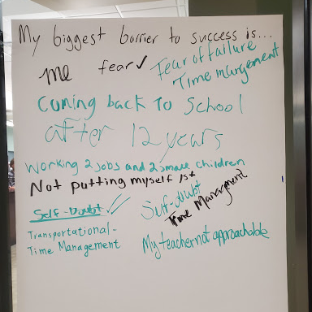
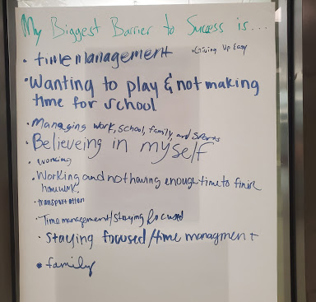
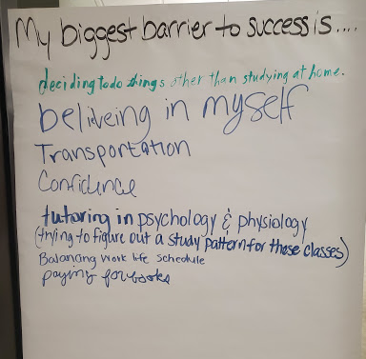

Slide 26
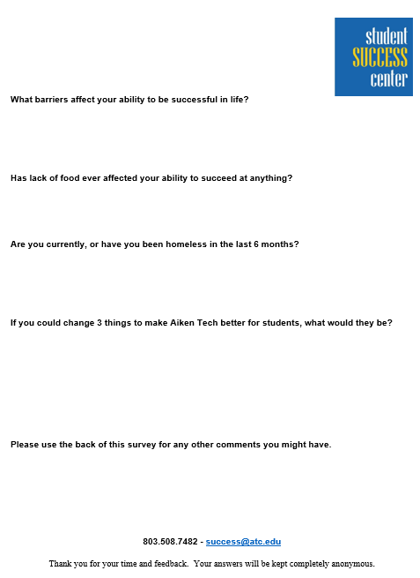

Slide 27
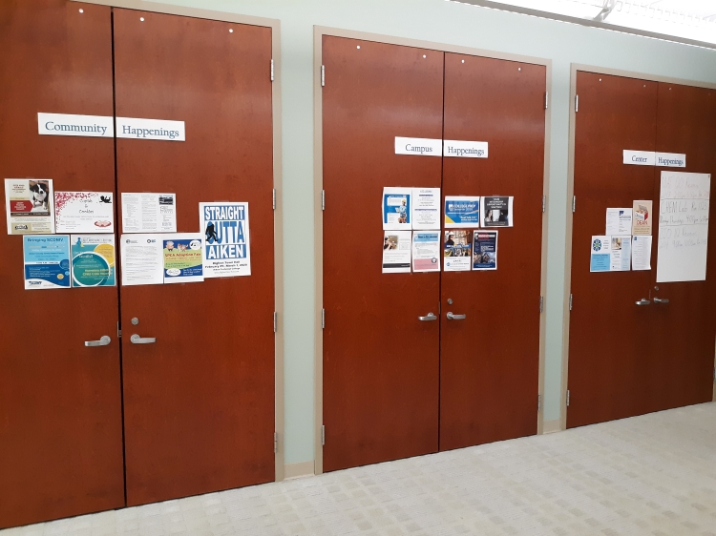
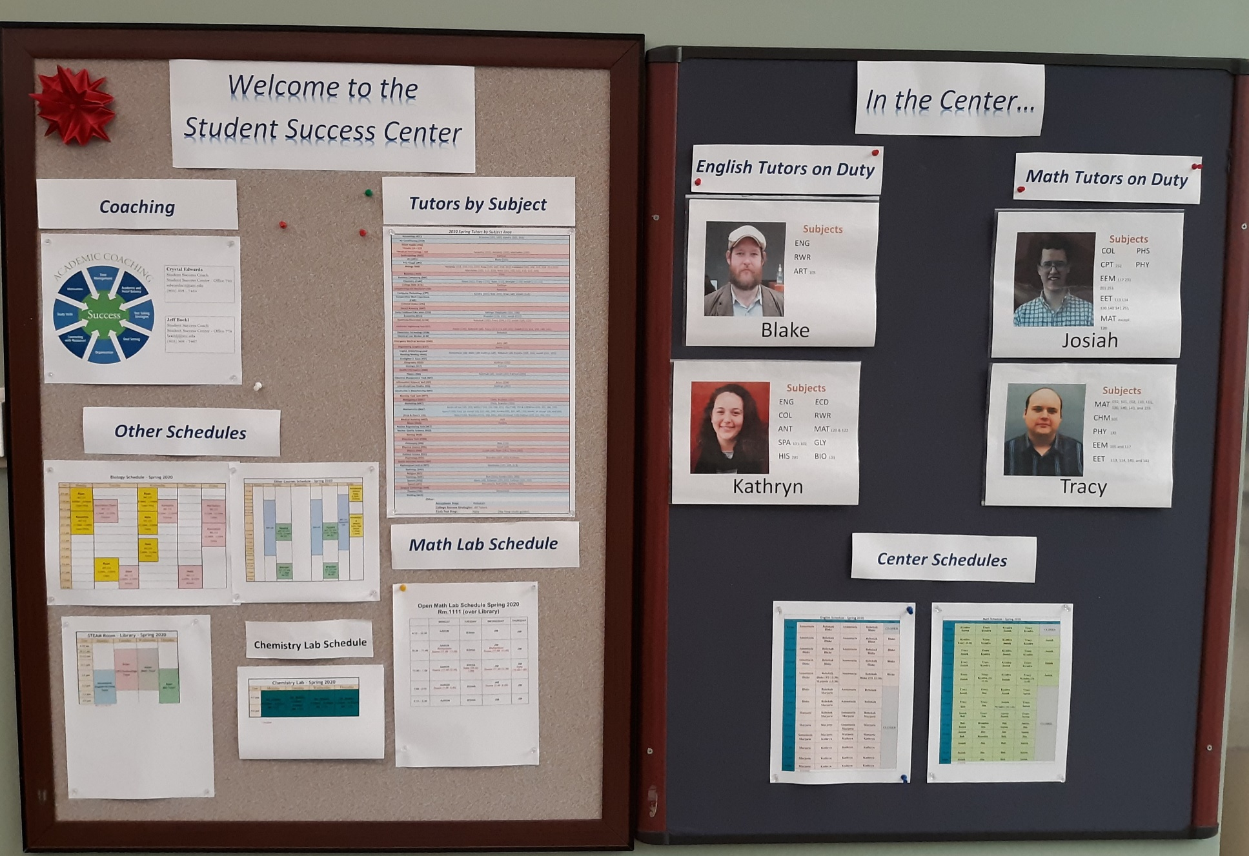
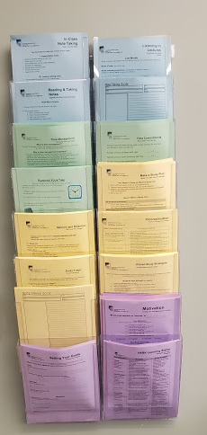

Slide 28
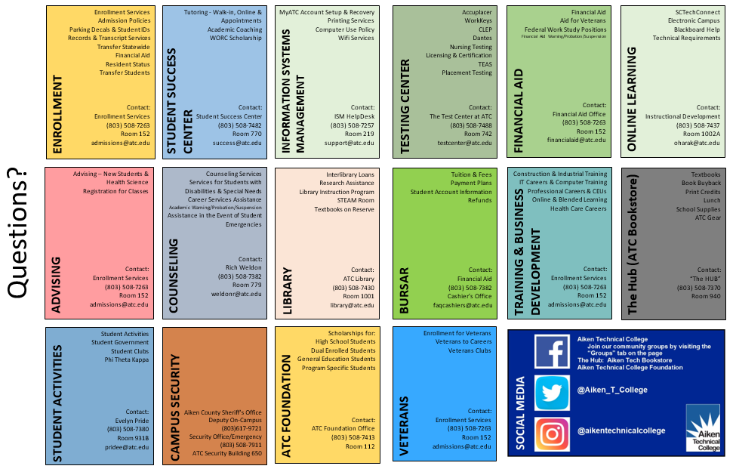
Other initiatives
Revamped Warning, Probation, Suspended Students
Redesign of COL 103 Course to Meet Student Needs
Your Experience
Your Success
Your Life
Your Future
OER
Cross-Divisional Collaboration

Slide 29
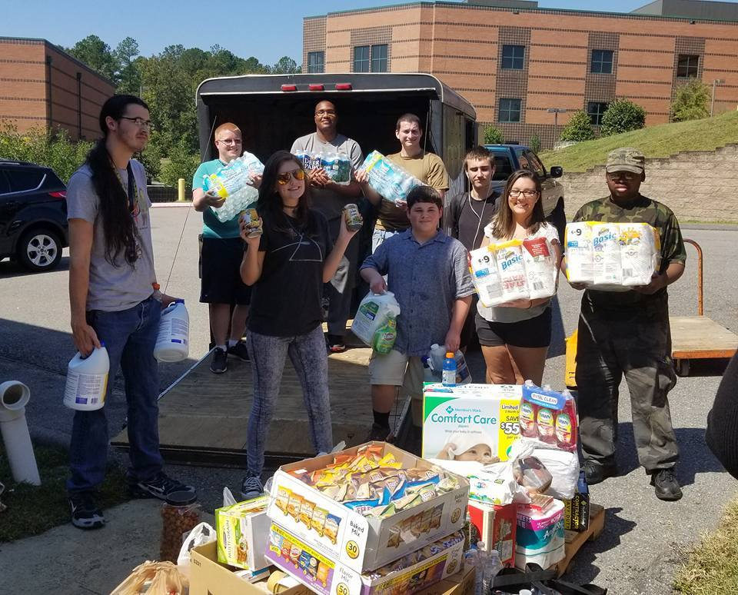

Slide 30
What else can be done?

Slide 31
Develop a Community of Caring
Culture change
Comes from the top
Be patient
Be open to change
Breakdown Silos & Collaborate
Identify Student & Institutional Barriers
Ask and Assess
Empower Faculty & Staff
Ensure the training needed is provided
Know your students’ name
Promote (and require) support services
Take the extra time with students
Breakdown barriers by designing services with students’ in mind
Wrap Around
21st Century Readiness Skills

Slide 32
“The number one issue for students is fear.”
"Love the students you have, not the ones you wished you had.”
"Quit punishing students for who they are.”
"Solution isn't intervention, students need us. Relationships have to be the core of intervention.”
Dr. Lowery-Hart , President
Amarillo College

Slide 33
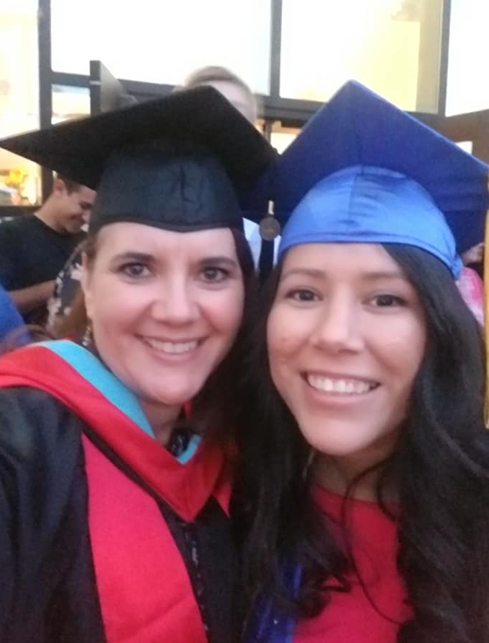
Our Ultimate Goal….
Notes:
Some of the most prized photos I have

Slide 34
Questions?
Crystal Ratliff
Dean, Student Success & Retention
Aiken Technical College
ratliffc@atc.edu
803.508.7483

